Slide 1

I got my sequence data: now what?
GrasPods
April 24
2019

Slide 2
I Need a Computer
Need to be able to run bioinformatics tools:
  Aligners
  Assemblers
  Variant callers, etc
But when complete I’ll need to create:
  Documents
  Presentations

Slide 3

I Need a Computer
Operating Systems
Install Biofx Tools
Tool support
Running Tools
Write Documents
Create Presentations
Server Connections

Slide 4
I Need a Computer
Storage
1 lane of HiSeqX genome data:
  800 million reads
  35X human genome coverage
  Bcl files: 50Gb
  Fastq files (gzipped): 50Gb
  BAM file: 50Gb
  VCF germline variants: 500Mb
150Gb required

Slide 5
I Need a Computer
Solution
ssh username@server
This Linux cluster is where you want to run your real analysis jobs.

Slide 6
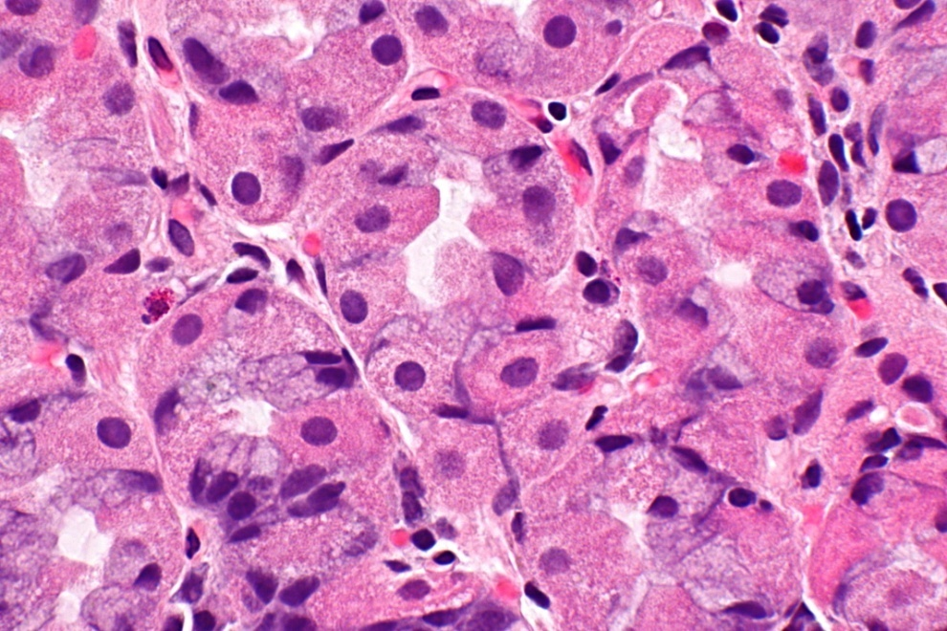
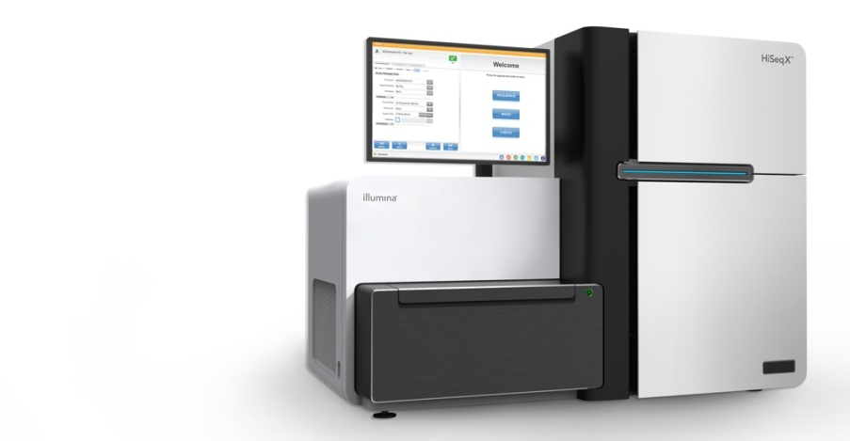

Illumina Sequencing
1.) Cells
4.) Sequencing
2.) DNA
5.) Paired-end Reads
Read 1
3.) Sheared DNA, with sequencing adapters
Read 2
AAAAAAAAAAAAAAAAACCCAAA--------------------CCCTTTTTGGGGAAGGGGGGGTT
TCCCCCCCCCCCCCCCAAAAAAAT ---------------------GAAAGGGAAAGGGGTTTCCCAAA
TCCCCGGGCCCCCCCCAAAAAAAT--------------------GAAAGGGAAAGGGGTTTCCCAAA
TCGCCGGCCCTCCACCAATAAAGT--------------------CTTTCCGATTGGCCTCCCCCAAAC
Reads.fastq1
Reads.fastq2
Notes:
Other dataypes can capture information about Gene Expression, or epigenetic information
23 base reads

Slide 7
Nanopore sequencing

Slide 8
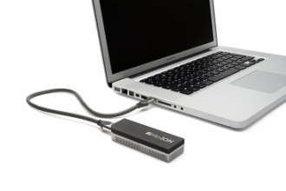
Sequence Data are Ready
ONT MinION
.fast5
.fastq
.bam
.vcf
Image Files
.bcl
Only on older Illumina sequencers

Slide 9
Sequence Data are Ready
Align of reads to a reference genome
OR
Assembly of the reads prior to alignment.
ONT MinION
.fast5
.fastq
.bam
.vcf
Image Files
.bcl
Call variants on your aligned data.
Only on older Illumina sequencers
Use a tool from Illumina, bcl2fastq for this conversion.
Some analysis software (eg. 10X) will work directly on .bcl files.

Slide 10
Using BASH
Command | example | explanation
ssh | ssh rcorbett@server.com | Connect to a remote server
cd | cd /home/rcorbett | Change directory
ls | ls /home/rcorbett | Get a list of files in a directory
mkdir | mkdir tmp | Make a directory
wget | wget http://index.html | Download files
cp | cp file1.txt file2.txt | Copy files
mv | mv file1.txt file2.txt | Move (ie. Rename) files
less | less file1.txt | View the file in the terminal, press ‘q’ to quit.
tail | tail file1.txt | See the last 10 lines of a file
ln -s | ln –s /usr/bin/genome.fa . | Link a file. Makes a pointer to another file
du | du bigFile.bam | Get a report of how large a file is
top | top | See what is running on a machine

Slide 11
Fastq files
>> head myFastq.fq1
@HISEQX3_11:1:1106:23531:45136/1
GCTTTATCAAGATAATTTTTCGACTCATCAGAAATATCCGAAA…
+
AAFFFKKKKKKKKKKKKKKKKKKKKKKKKKKKKKKKKKKKKKKK…
@HISEQX3_11:1:1117:8440:33832/1
GCGCAACCTGTGACGACAAATCTGCTCAAATTTATGCGCGCT…
+
AAFFFKKKKKKKKKKKKKKKKKKKKKKKKKKKKKKKKKKKKKKK…
….
Run Number
Coordinates
@HISEQX3_11:1:1117:8440:33832/1
Sequencer Name
Lane

Slide 12
Alignment
AGCCCTAGGATAGCTTA
AGCCCTAGGATAGCTTA
AGCTAGCCCTAGGATAG
AGCCCTAGGATAGCTTA
AGCCCTAGGATAGCTTA
TAGCTAGCCCTAGGATA
CTAGCTAGCCCTAGGAT
Fastq
AGCCCTAGGATAGCTTA
AGCCCTAGGATAGCTTA
Reference Genome
...ACTCGCTAGCTAGCCCTAGGATAGCTTAGAGACCCTCGCGAAATAGACCCTCGAT...
AGCCCTAGGATAGCTTA
ACCCTCGCGAAATAGAC
AGCTAGCCCTAGGATAG
ACCCTCGCGAAATAGAC
TAGCTAGCCCTAGGATA
GACCCTCGCGAAATAGA
CTAGCTAGCCCTAGGAT
AGACCCTCGCGAAATAG
SAM/BAM
GCTAGCTAGCCCTAGGA
TAGAGACCCTCGCGAAA
GCTAGCTAGCCCTAGGA
CTTAGAGACCCTCGCGA
GCTAGCTAGCCCTAGGA
CTTAGAGACCCTCGCGA
GCTAGCTAGCCCTAGGA

Slide 13
SAM/BAM files - header
>> head phiX.sam
@SQ SN:gi|9626372|ref|NC_001422.1| LN:5386
@PG ID:minimap2 PN:minimap2 VN:2.16-r922 CL:minimap2 -ax sr phi_plus_SNPs.idx HJVH5CCXX_1_GTCGTT.p000001.bam.fq1 HJVH5CCXX_1_GTCGTT.p000001.bam.fq2
HISEQX3_11:1:1106:23531:45136 83 gi|9626372|ref|NC_001422.1| 1 48 72S78M = 1 -78 CCTGCTGAACCGCTCTTCCGATCTCTTCTGCGTCATGGAAGCGATAAAAATGATTGGCGTATCCAACCTGCAGAGTTTTATCGCTTCCATGACGCAGAAGTTAACACTTTCGGATATTTCTGATGAGTCGAAAAATTATCTTGATAAAGC KKKKFKKKFKKFKKKKKFKKKKKFAKKKAKKKKKKKKKFFKKKKKKKKKKKKKKKKKKKKKKKKKKKKKKKKKKKKKKKKKKKKKKKKKKKKKKKKKKKKKKKKKKKKKKKKKKKKKKKKKKKKKKKKKKKKKKKKKKKKKKKKKFFFAA NM:i:0 ms:i:156 AS:i:156 nn:i:0 tp:A:P cm:i:3 s1:i:25 s2:i:0 de:f:0 SA:Z:gi|9626372|ref|NC_001422.1|,5356,-,41S31M78S,1,0; rl:i:0
HISEQX3_11:1:1106:23531:45136 2129 gi|9626372|ref|NC_001422.1| 5356 1 41H31M78H = 1 -5386 CGATAAAAATGATTGGCGTATCCAACCTGCA KKKKKKKKKKKKKKKKKKKKKKKKKKKKKKK NM:i:0 ms:i:62 AS:i:62 nn:i:0 tp:A:P cm:i:1 s1:i:27 s2:i:0 de:f:0 SA:Z:gi|9626372|ref|NC_001422.1|,1,-,72S78M,48,0; rl:i:0
@SQ lines tell you about your reference
@PG lines tell you which commands were used

Slide 14
SAM/BAM files - records
>> head phiX.sam
@SQ SN:gi|9626372|ref|NC_001422.1| LN:5386
@PG ID:minimap2 PN:minimap2 VN:2.16-r922 CL:minimap2 -ax sr phi_plus_SNPs.idx HJVH5CCXX_1_GTCGTT.p000001.bam.fq1 HJVH5CCXX_1_GTCGTT.p000001.bam.fq2
HISEQX3_11:1:1106:23531:45136 83 gi|9626372|ref|NC_001422.1| 1 48 72S78M = 1 -78 CCTGCTGAACCGCTCTTCCGATCTCTTCTGCGTCATGGAAGCGATAAAAATGATTGGCGTATCCAACCTGCAGAGTTTTATCGCTTCCATGACGCAGAAGTTAACACTTTCGGATATTTCTGATGAGTCGAAAAATTATCTTGATAAAGC KKKKFKKKFKKFKKKKKFKKKKKFAKKKAKKKKKKKKKFFKKKKKKKKKKKKKKKKKKKKKKKKKKKKKKKKKKKKKKKKKKKKKKKKKKKKKKKKKKKKKKKKKKKKKKKKKKKKKKKKKKKKKKKKKKKKKKKKKKKKKKKKKFFFAA NM:i:0 ms:i:156 AS:i:156 nn:i:0 tp:A:P cm:i:3 s1:i:25 s2:i:0 de:f:0 SA:Z:gi|9626372|ref|NC_001422.1|,5356,-,41S31M78S,1,0; rl:i:0
HISEQX3_11:1:1106:23531:45136 2129 gi|9626372|ref|NC_001422.1| 5356 1 41H31M78H = 1 -5386 CGATAAAAATGATTGGCGTATCCAACCTGCA KKKKKKKKKKKKKKKKKKKKKKKKKKKKKKK NM:i:0 ms:i:62 AS:i:62 nn:i:0 tp:A:P cm:i:1 s1:i:27 s2:i:0 de:f:0 SA:Z:gi|9626372|ref|NC_001422.1|,1,-,72S78M,48,0; rl:i:0
Bitwise flag
Position
Read name
Reference name
Map Q
HISEQX3_11:1:1106:23531:45136 83 gi|9626372|ref|NC_001422.1| 1 48 72S78M = 1 -78 CCTGCTGAACCGCTCTTCCGAT… KKKKFKKKFKKFKKKKKFKKKKKF …
Mate reference
Mate Position
Insert Size
Sequence
Base Qualities
CIGAR

Slide 15
Recommended Tools
Genome
  Alignment: BWA, Minimap2
  SAM/BAM handling: Sambamba
  Variant Calling: Strelka2, Mutect2
RNA
  Alignment: STAR
  Expression Quantification: HTSeq
  SAM/BAM handling: Sambamba

Slide 16
Storage
1 lane of HiSeqX genome data:
  800 million reads
  35X human genome coverage
  Bcl files: 50Gb
  Fastq files (gzipped): 50Gb
  BAM file: 50Gb
  VCF germline variants: 500Mb
150Gb required

Slide 17
Compute
Less limiting than storage

Slide 18
BASH Examples
ssh rcorbett@ssh.bcgsc.ca #The GSC ssh server

