Slide 1
SVIA group figures for petabase party

Slide 2
Actionable and clinically relevant mutations are identified and reported to clinicians ahead of presentations

Slide 3
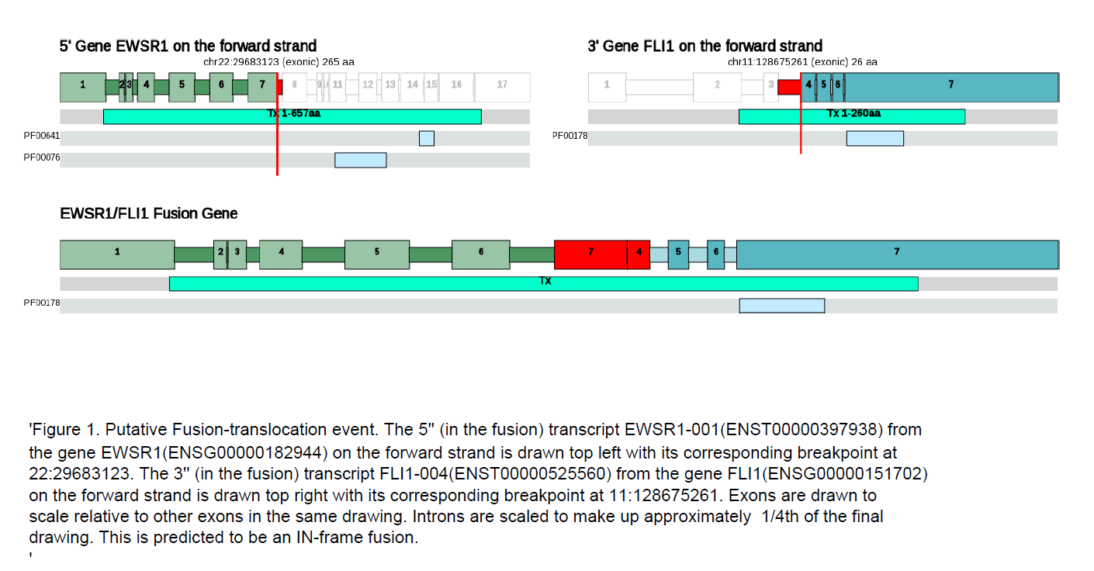
A diagram showing the structure of the gene fusion

Slide 4
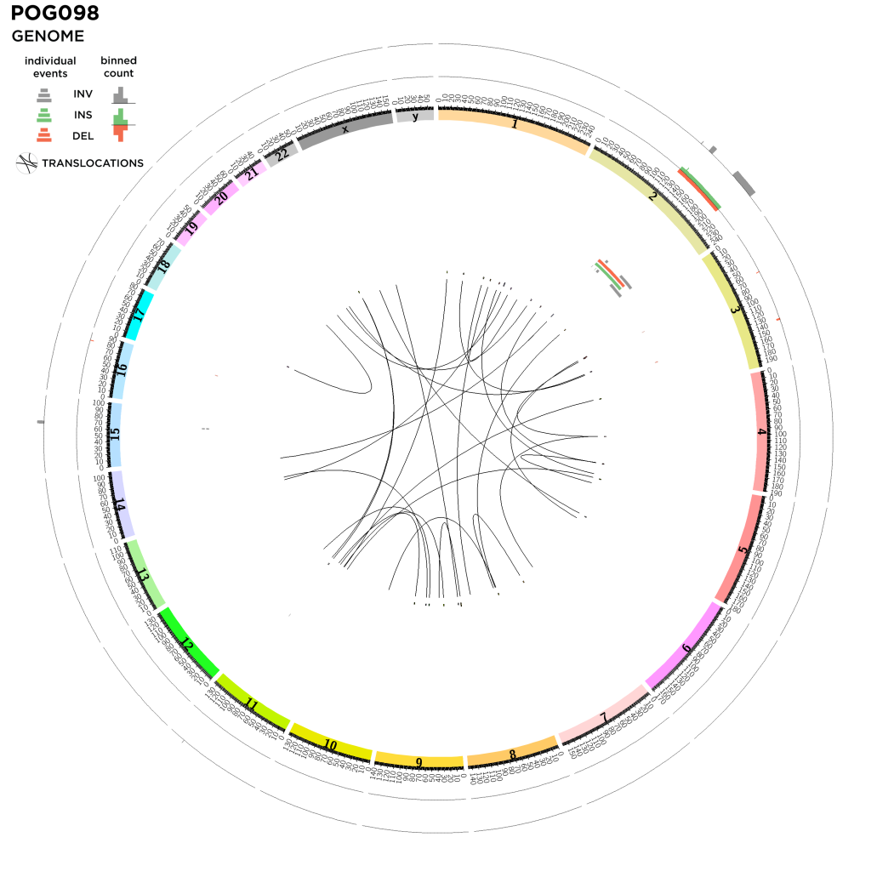
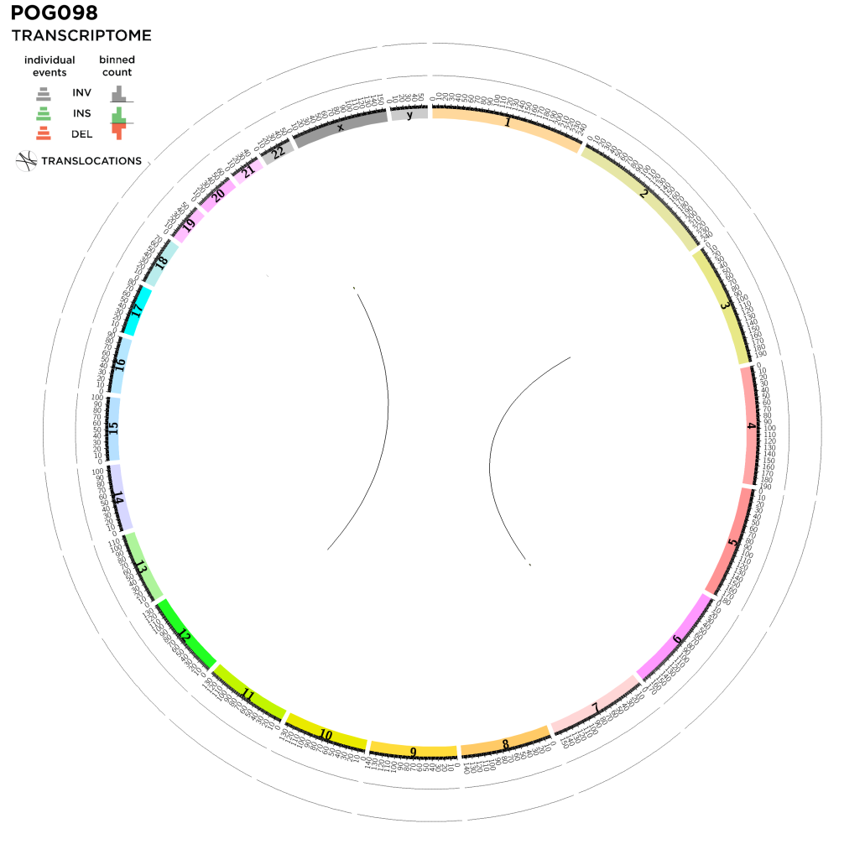
A subset of structural variants are summarized in CIRCOS plots
P
P
EWSR1
EWSR1
FLI1
FLI1

Slide 5
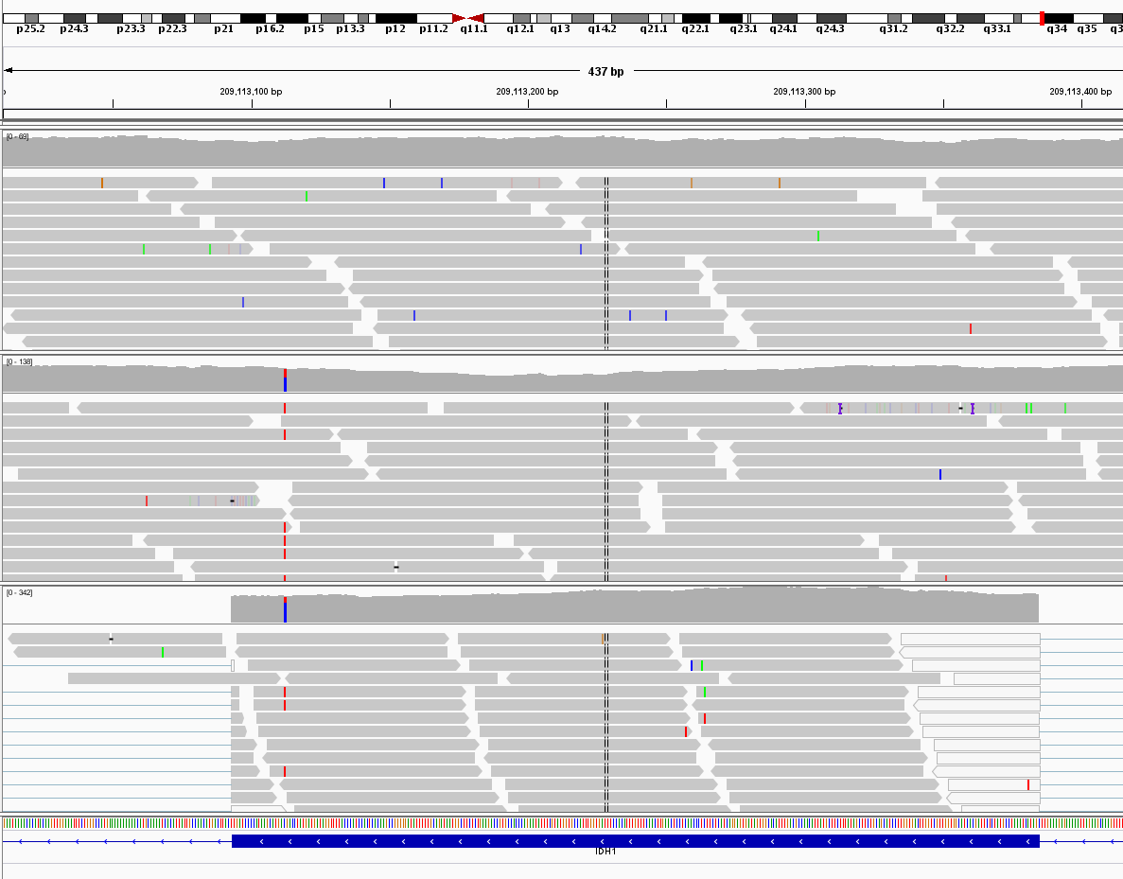
Variants are reviewed to confirm somatic status
Normal
genome
Tumour
genome
Tumour
transcriptome

Slide 6
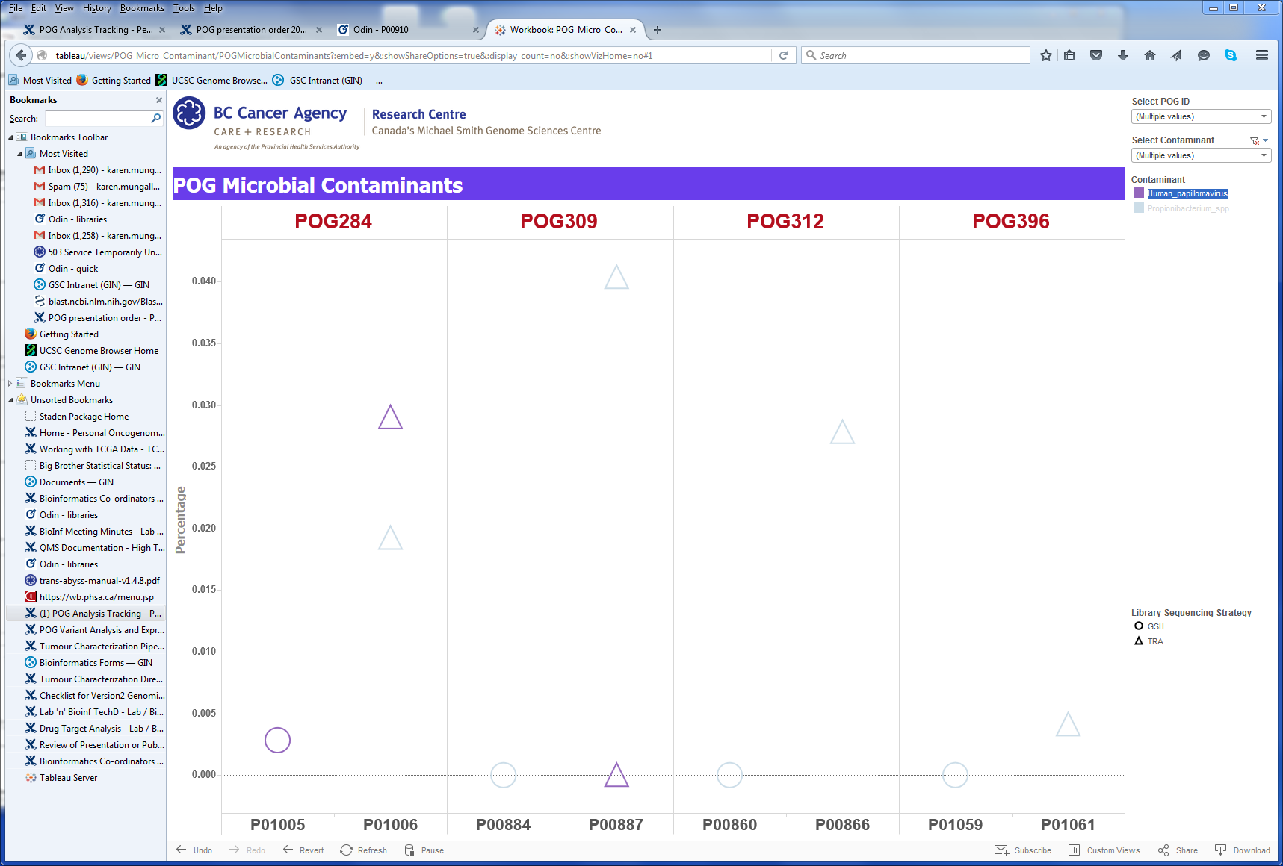
Tableau views show microbial contaminants in samples
Library sequencing strategy
GSH
TRA
Detected microbe
Propionibacterium
HPV
Example shows Human papilloma virus (HPV) and Propionibacterium levels in four POG samples

Slide 7
P
EWSR1
FLI1
Normal
genome
Tumour
genome
Tumour
transcriptome
Library sequencing strategy
Detected microbe
GSH
Propionibacterium
TRA
HPV

