Slide 1
RETHINKING GENOME BROWSING:
NAVIGATION BY FUNCTION NOT POSITION
CYDNEY NIELSEN
Postdoctoral Fellow
February 17, 2012

Slide 2
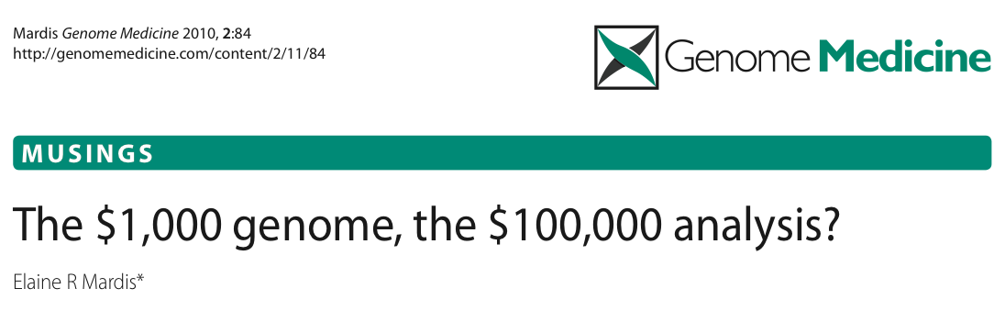

Slide 3
The challenges of having so much data
Most challenging of all, it will be of critical importance to develop meta-analyses and statistical analysis tools that integrate across disparate data types, …
… thereby enable researchers to collectively interpret these data for all samples in a study and to form testable hypotheses from this discovery phase.
- Elaine Mardis
Anticipating the $1,000 genome

Slide 4
The challenges of having so much data
Most challenging of all, it will be of critical importance to develop meta-analyses and statistical analysis tools that integrate across disparate data types, …
… thereby enable researchers to collectively interpret these data for all samples in a study and to form testable hypotheses from this discovery phase.
- Elaine Mardis
Anticipating the $1,000 genome
Data visualization will be a key player in this domain

Slide 5
Why visualization?
Data landscape is unknown
In the discovery phase, not yet clear where the interesting features lie or what they look like
Features are not sufficiently well defined to be extracted in a purely automated fashion
Visualization is a powerful approach in such cases:
Exploit our visual system and knowledge to identify biologically interesting data patterns and subsequently generalize

Slide 6
Why visualization?
Data landscape is unknown
In the discovery phase, not yet clear where the interesting features lie or what they look like
Features are not sufficiently well defined to be extracted in a purely automated fashion
Visualization is a powerful approach in such cases:
Exploit our visual system and knowledge to identify biologically interesting data patterns and subsequently generalize

Slide 7
Why visualization?
Improves data accessibility to biological community

Slide 8
Why visualization?
Improves data accessibility to biological community
More and more data are being produced from large consortia (ENCODE, Epigenome Roadmap Project, etc.)
Download portals are valuable, but of primary use to computational experts
If we are to make the most of these large datasets, need to bridge the computational gap between primary data and biological community – visualization can play a key role

Slide 9
Outline
Exploring genome-wide datasets
  Computational and visual methods to investigate ChIP-Seq data
Spark
  A navigational paradigm for interactive genome exploration
Demo
Future work

Slide 10
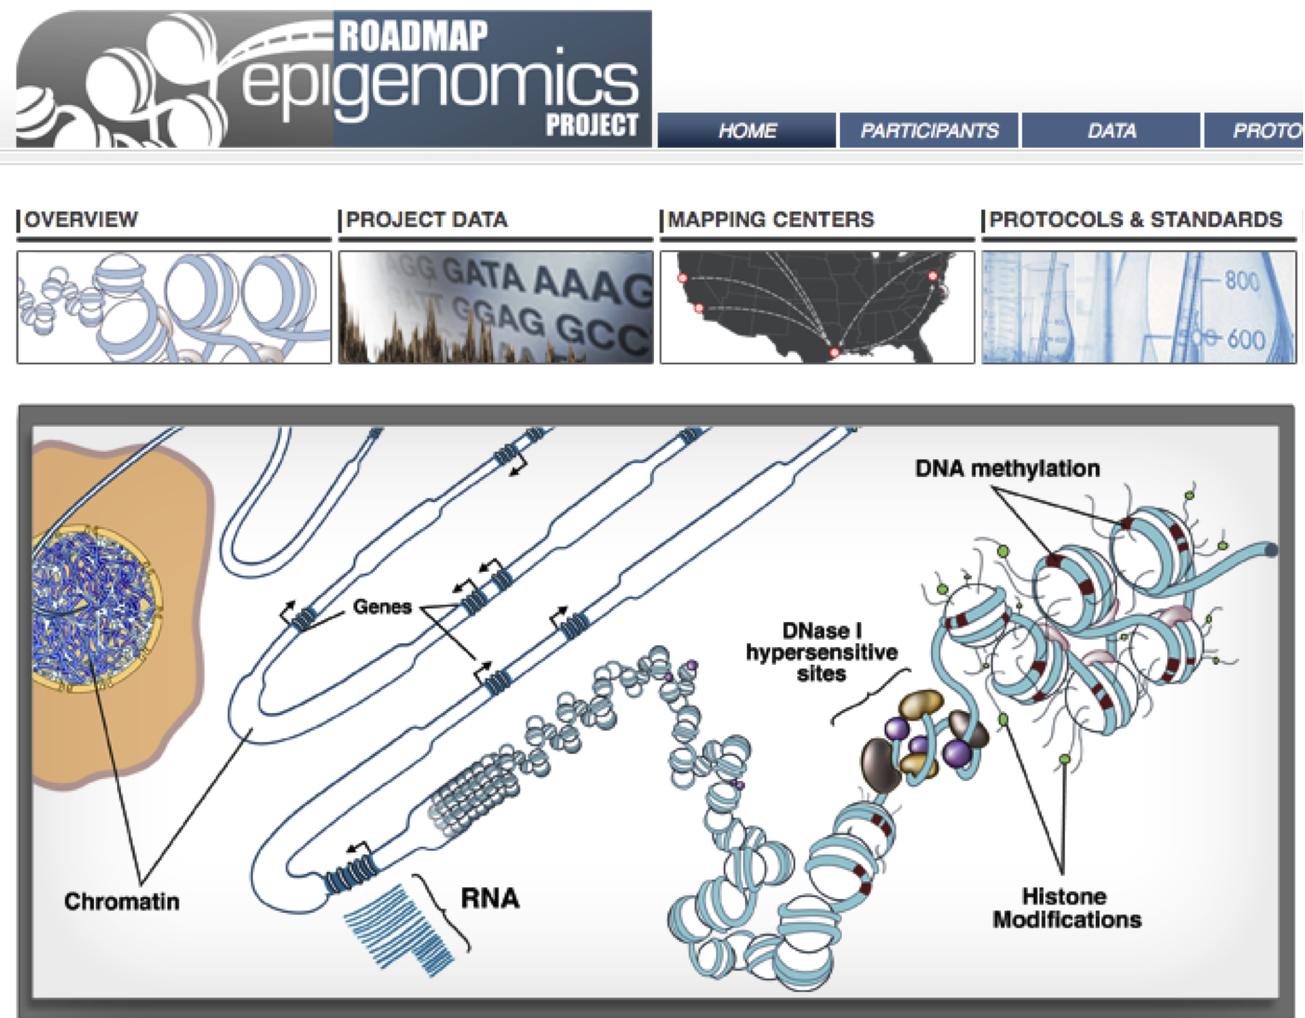
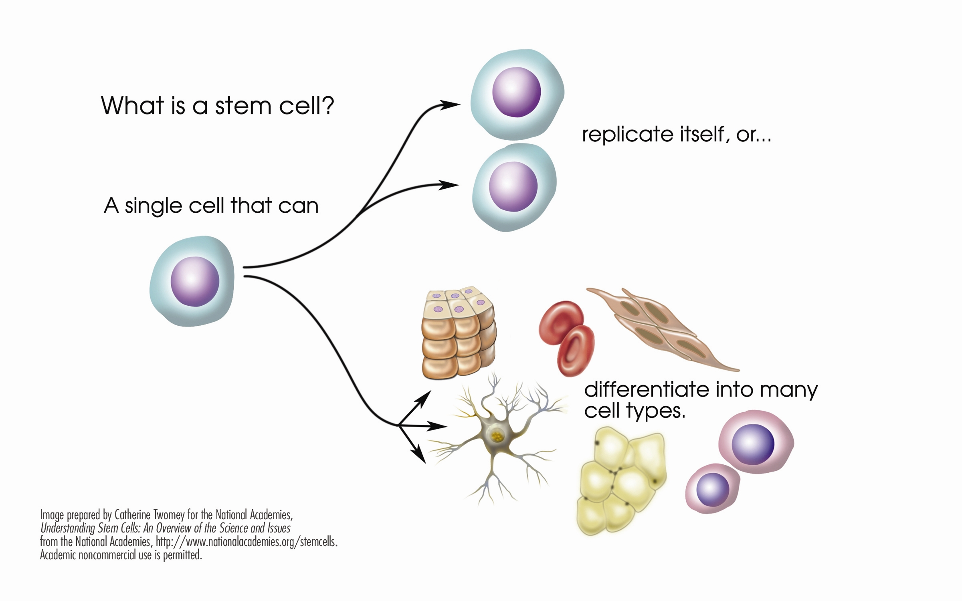
Many cell types with same DNA sequence but different morphologies
Stem cell
Differentiated cells
www.nationalacademies.org/stemcells
Notes:
One fundamental question in biology is what defines cell state
One explanation for how this is possible has to do with epigenetic changes

Slide 11
Epigenetics - the study of changes in the regulation of gene activity that are not dependent on gene sequence
epi - (above) – genetics
Notes:
DNA is not free in a cell, but rather heavily packaged
DNA wound around histone proteins, higher order structures
Some areas are more loosely packaged than others, enabling access to the transcriptional machinery and giving rise to RNA expression (active genes)
What parts of the genome are transcriptionally active or silenced helps dictate the cell type
Modifications to the DNA itself or to parts of the histone proteins influences this packaging
Some debate about which marks are considered epigenetic

Slide 12
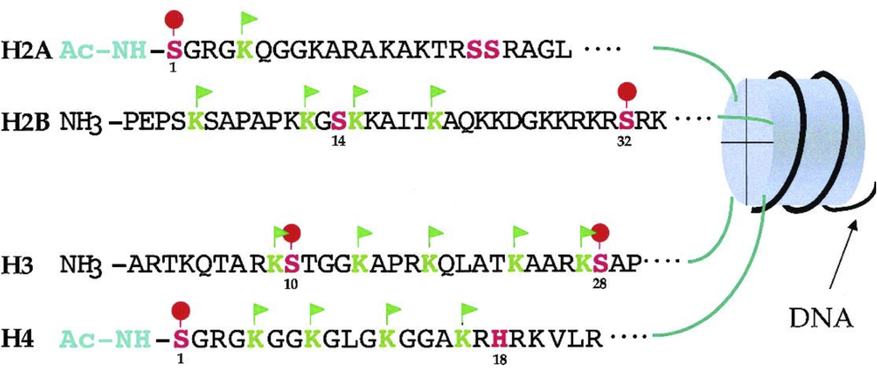
Epigenetics - the study of changes in the regulation of gene activity that are not dependent on gene sequence
epi - (above) – genetics
http://bricker.tcnj.edu/Amb/amble9.html

Slide 13
Epigenetics - the study of changes in the regulation of gene activity that are not dependent on gene sequence
epi - (above) – genetics
H3K9Ac
http://bricker.tcnj.edu/Amb/amble9.html
Notes:
On histone 3, the ninth lysine is acetylated

Slide 14
A Roadmap Project goal is to create reference epigenomic maps of many different human cell types (i.e. a map of histone modifications across the genome)
Stem cell
Differentiated cells

Slide 15
A Roadmap Project goal is to create reference epigenomic maps of many different human cell types (i.e. a map of histone modifications across the genome)
Stem cell
Differentiated cells
Developmentally important genes are “poised”:
H3K4me3 (active) AND H3K27me3 (inactive)
Resolve to either
H3K4me3 OR H3K27me3

Slide 16
A Roadmap Project goal is to create reference epigenomic maps of many different human cell types (i.e. a map of histone modifications across the genome)
reversible
Stem cell
Differentiated cells
Developmentally important genes are “poised”:
H3K4me3 (active) AND H3K27me3 (inactive)
Resolve to either
H3K4me3 OR H3K27me3

Slide 17
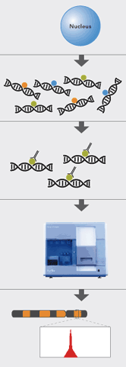

ChIP-Seq |
Chromatin Immunoprecipitation and Sequencing
Cross-link and fractionate chromatin
ChIP - enrich for targeted binding sites
Sequence
Map sequence to reference genome
Peak = putative binding site
Notes:
Sequencing revolution has made this kind of genome-wide profiling feasible

Slide 18
Current computational techniques
Heintzman et al. Nature Genetics, 2007
Motivation – “…the distinguishing chromatin features of promoters and enhancers have yet to be determined, hindering our understanding of a predictive histone code for different classes of regulatory elements.”

Slide 19
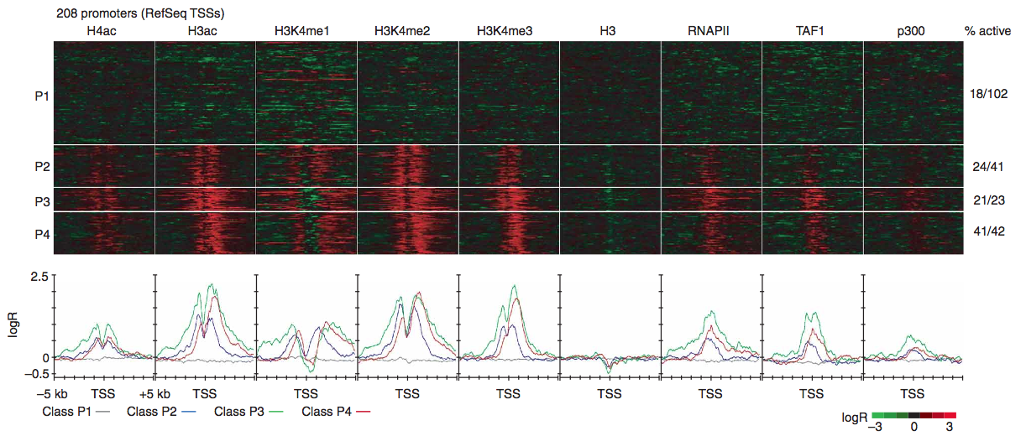
Current computational techniques
Heintzman et al. Nature Genetics, 2007
Clustering data from well annotated regions
Notes:
signature detection: clustering well-annotated promoters on the basis of specific histone modification patterns derived from chromatin immunoprecipitation (ChIP) coupled microarray data (ChIP-chip)

Slide 20
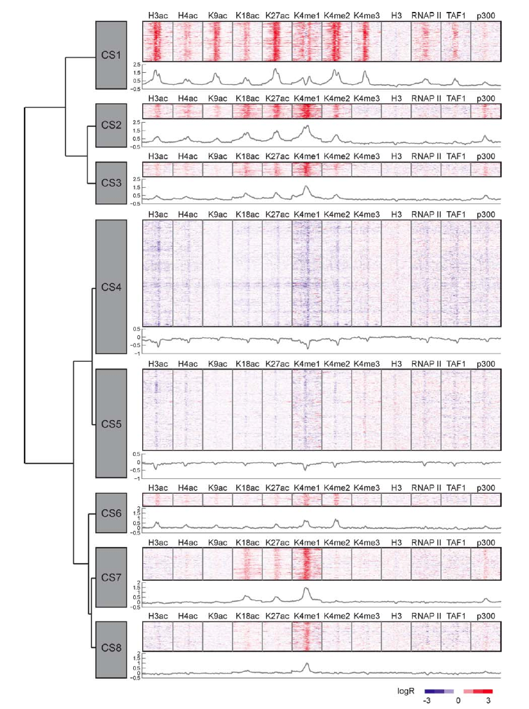
Current computational techniques
Hon et al.
PLoS Comput. Biol., 2008
ChromaSig: a probabilistic method that enables discovery of chromatin signatures de novo (no dependence on annotation)
Notes:
A probabilistic method, ChromaSig, subsequently eliminated the dependence on existing annotations and offered a way to discover chromatin signatures de novo by searching genome-wide using data from ChIP followed by sequencing (ChIP-seq)

Slide 21
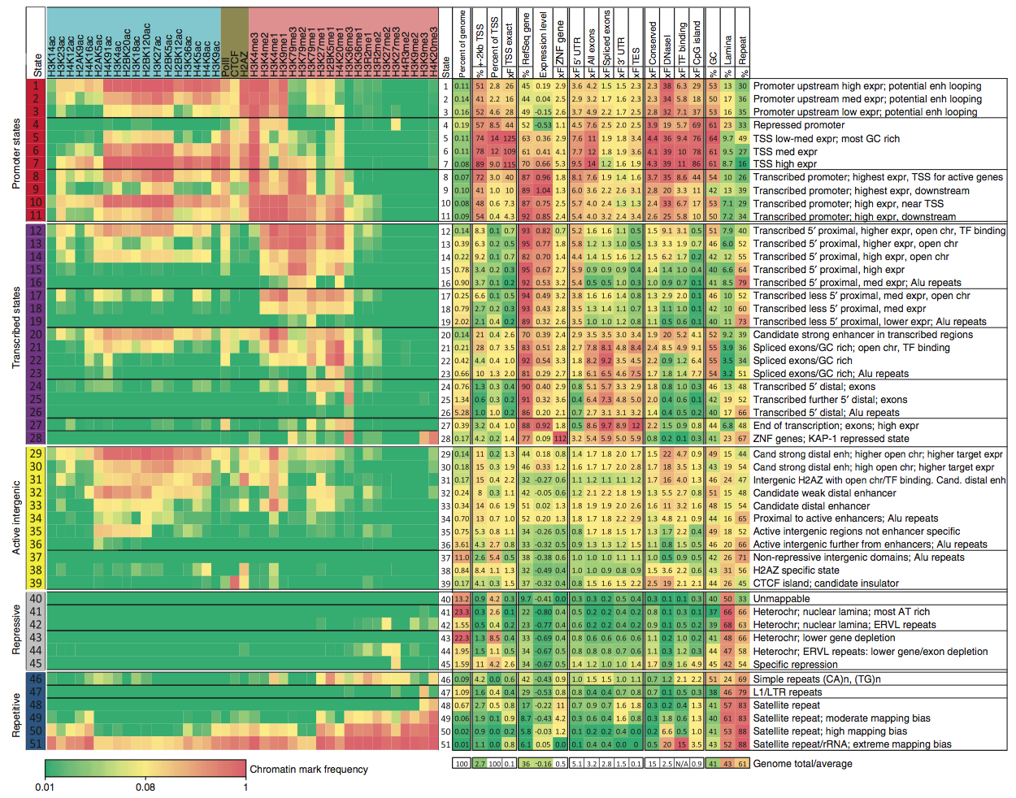
Current computational techniques
Ernst and Kellis
Nature Biotechnol.
2010
Hidden Markov Model to reveal 'chromatin states' in human T cells
State display: abstracted away from all detail of primary data

Slide 22
Current computational techniques
Require significant computational skill to use (only ChromaSig provides an implementation)
All produce static overview images and do not support interactive data exploration of individual genes within a signature class
No integration with downstream processing (e.g. gene ontology enrichments, etc.)

Slide 23
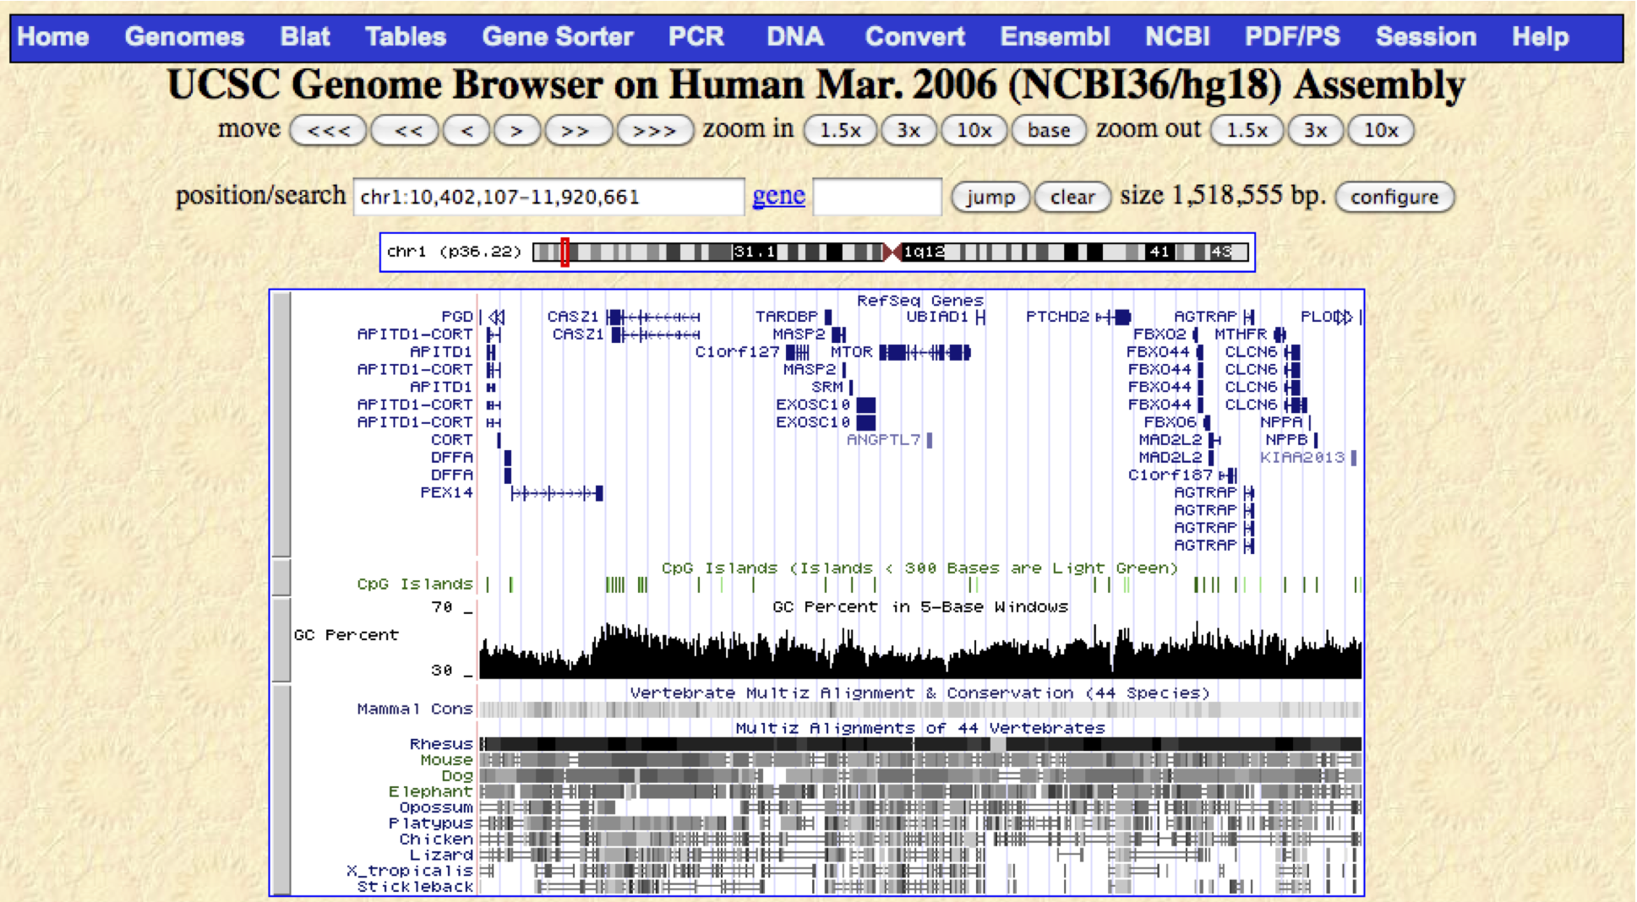
Current visualization techniques

Slide 24
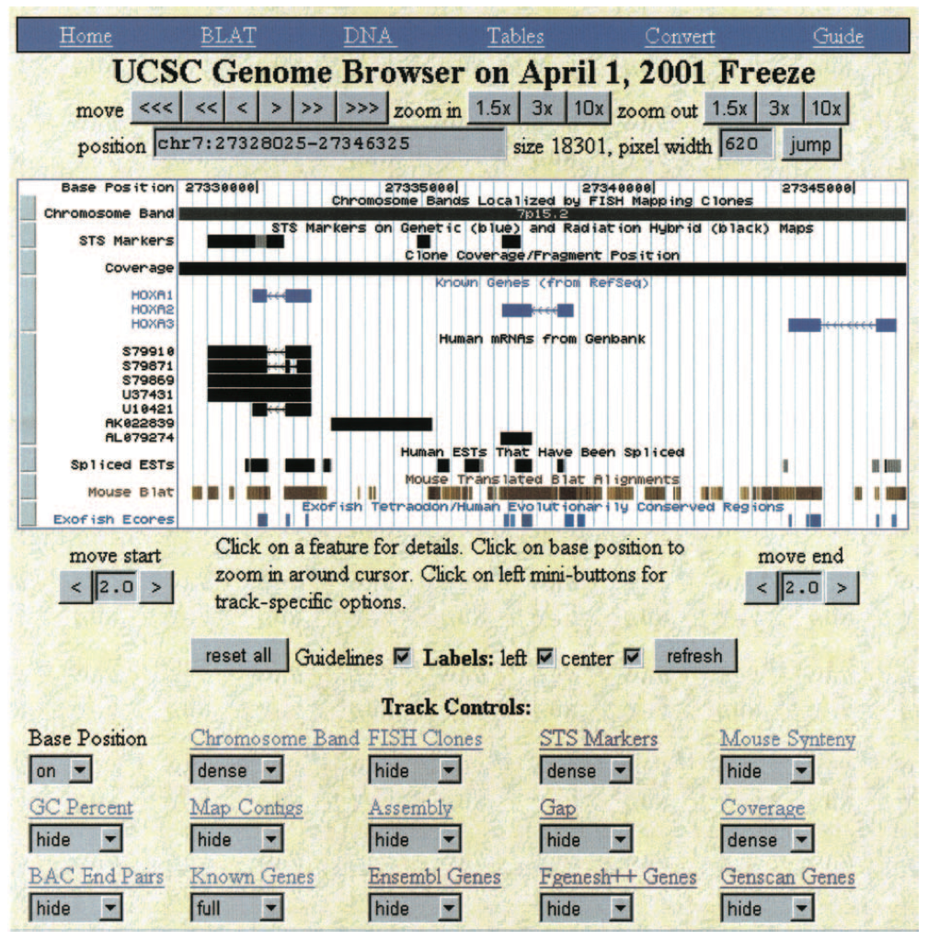
Kent et al. Genome Research, 2002

Slide 25
“The UCSC browser had humble origins. The code originated with a small script in the C programming language, which displayed a splicing diagram for a gene prediction from the nematode C. elegans (Kent and Zahler 2000). This web-based splicing display later acquired tracks for mRNA alignments and for homology with the related nematode Caenorhabditis briggsae. This was published as the tracks display at http://www.cse.ucsc.edu/∼kent/intronerator”
Kent et al. Genome Research, 2002

Slide 26
Current visualization techniques
Genome Browsers
Intended to provide a local view of a genomic region
In the absence of other tools, many biologists attempt to informally use them to gather a global overview of data patterns
In these cases, there is a mismatch between the level of data abstraction at which a biologist reasons about the problem and the level provided by the browser
Functional similarity should drive navigation not genomic position

Slide 27
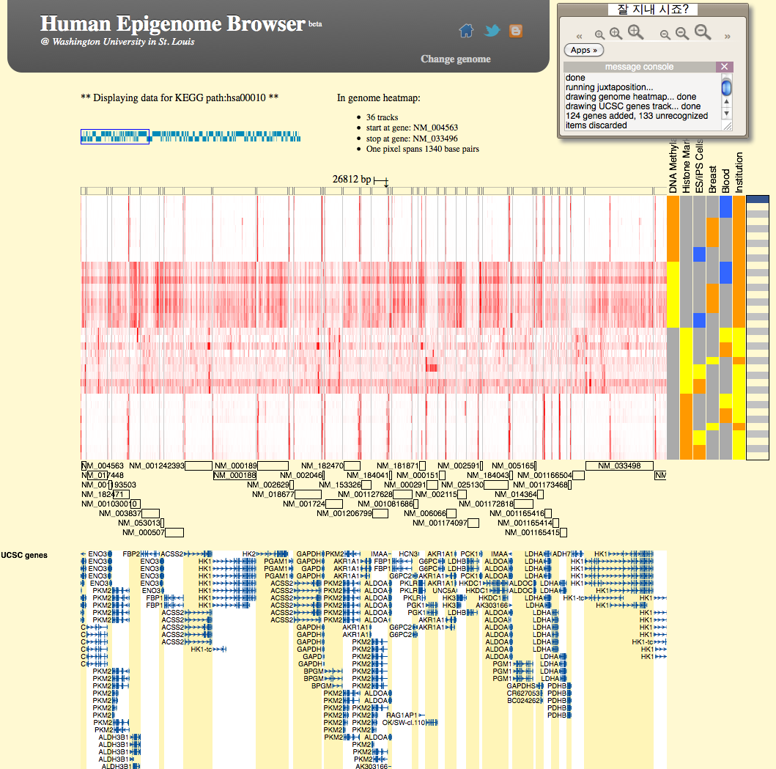
Current visualization techniques
Zhou et al. Nature Methods, 2011
Can filter genomic x-axis to just display genes from a pathway of interest (by KEGG ID)

Slide 28
Spark – A Discovery Tool
Notes:
For this reason, we developed Spark as a complement to genome browsing. As its name implies, it is intended as a discovery tool to facilitate data exploration and hypothesis generation.
The approach focuses on user specified regions of interest, such as TSSs.
3. The software then extracts data matrices that are essentially slices through the data tracks at the regions of interest. These matrices are transformed to have the same relative orientation (e.g. all TSSs are oriented 5’ to 3’ independent of strand).
4. We then apply a normalization function in order to make the values from different samples comparable. Essentially, this scales the binned data values to be between 0 and 1, with 0.5 corresponding to the median value for the sample. This normalization method was adopted from ChromaSig.
5. Finally, the matrices are clustered using k-means clustering
Some details:
We use the Euclidean distance metric in the clustering
This clustering is for Refseq TSSs +/- 3 kb and is binned into 300 nt bins (20 bins total in each matrix)
The Refseqs TSSs have been filtered to remove TSSs separated by 1 kb or less.

Slide 29
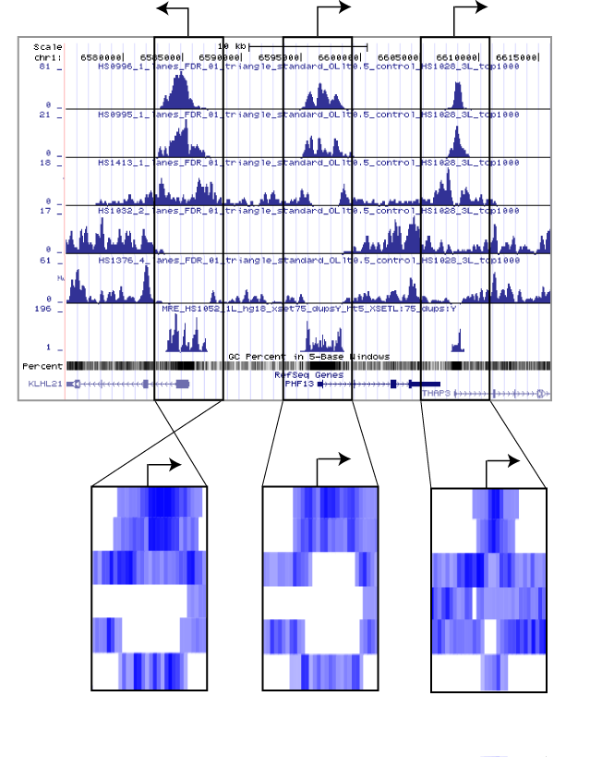
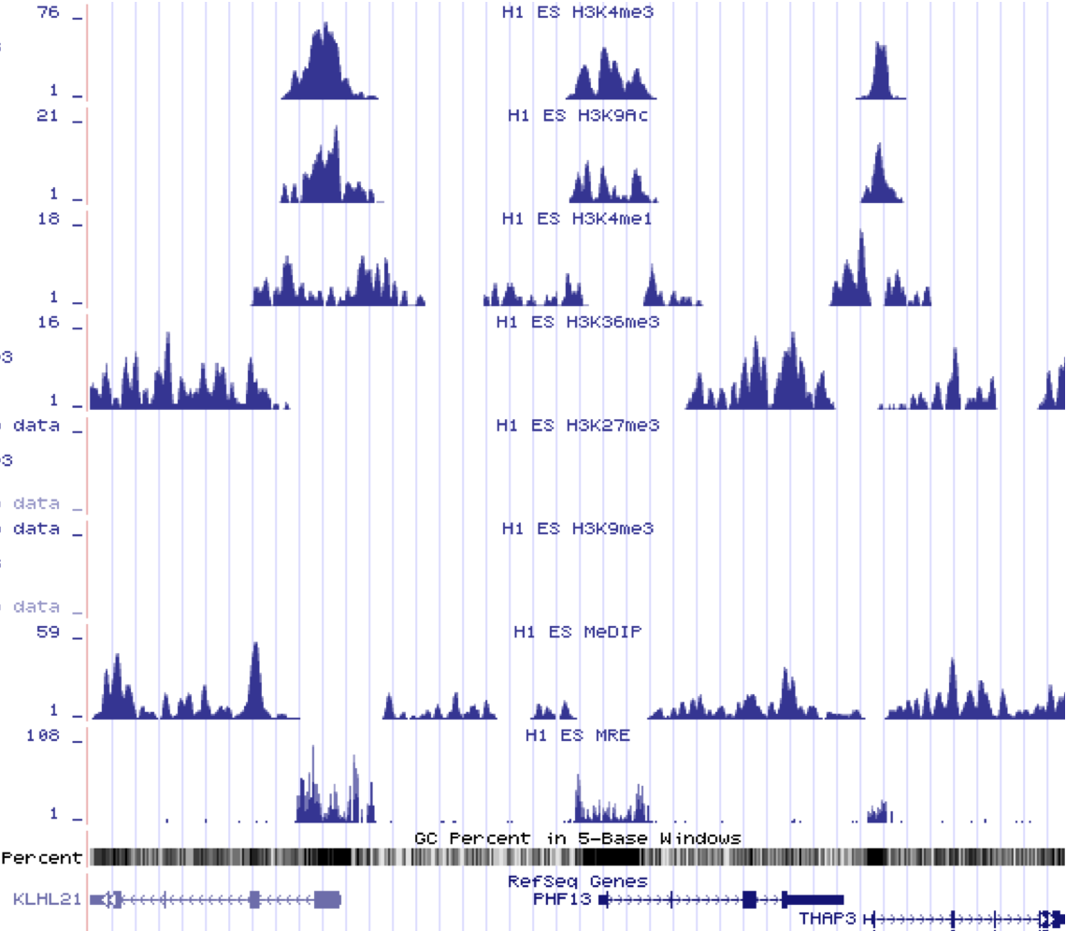

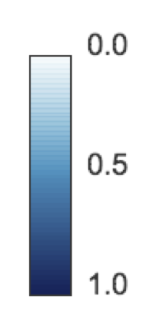



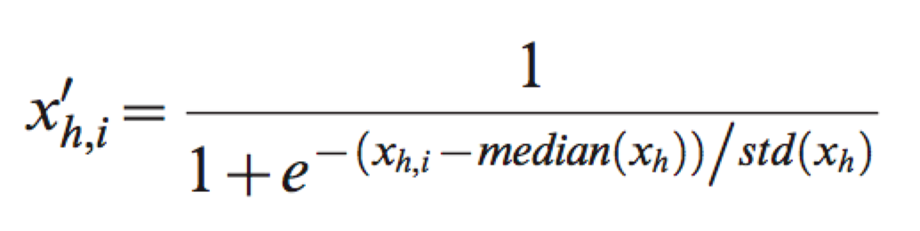
Spark
1. Focus on regions of interest (e.g. transcriptional start sites (TSSs) +/- 3000 nt)
H3K4me3
H3K9Ac
H3K4me1
H3K36me3
H3K27me3
H3K9me3
MeDIP
MRE
2. Extract data matrices
Normalization for bin i, sample h:
median
frequency
0.0
0.5
1.0
values
Notes:
For this reason, we developed Spark as a complement to genome browsing. As its name implies, it is intended as a discovery tool to facilitate data exploration and hypothesis generation.
The approach focuses on user specified regions of interest, such as TSSs.
3. The software then extracts data matrices that are essentially slices through the data tracks at the regions of interest. These matrices are transformed to have the same relative orientation (e.g. all TSSs are oriented 5’ to 3’ independent of strand).
4. We then apply a normalization function in order to make the values from different samples comparable. Essentially, this scales the binned data values to be between 0 and 1, with 0.5 corresponding to the median value for the sample. This normalization method was adopted from ChromaSig.
5. Finally, the matrices are clustered using k-means clustering
Some details:
We use the Euclidean distance metric in the clustering
This clustering is for Refseq TSSs +/- 3 kb and is binned into 300 nt bins (20 bins total in each matrix)
The Refseqs TSSs have been filtered to remove TSSs separated by 1 kb or less.

Slide 30
Spark
1. Focus on regions of interest (e.g. transcriptional start sites (TSSs) +/- 3000 nt)
H3K4me3
H3K9Ac
H3K4me1
H3K36me3
H3K27me3
H3K9me3
MeDIP
MRE
2. Extract data matrices
Normalization for bin i, sample h:
median
frequency
0.0
0.5
1.0
values

Slide 31


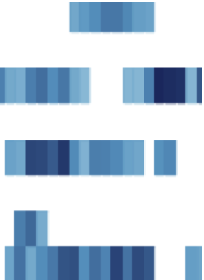



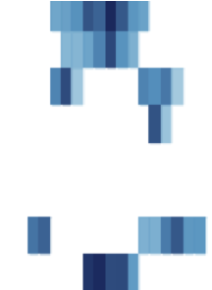

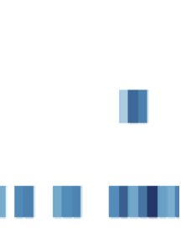
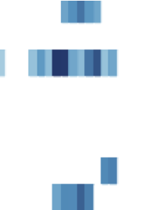
Spark
3. Cluster matrices (k-means)
Notes:
K-means clustering: simple, easy to understand, and fast and local enough to be interactive

Slide 32
Spark
3. Cluster matrices (k-means)
k = 3
Cluster 1
Cluster 2
Cluster 3

Slide 33
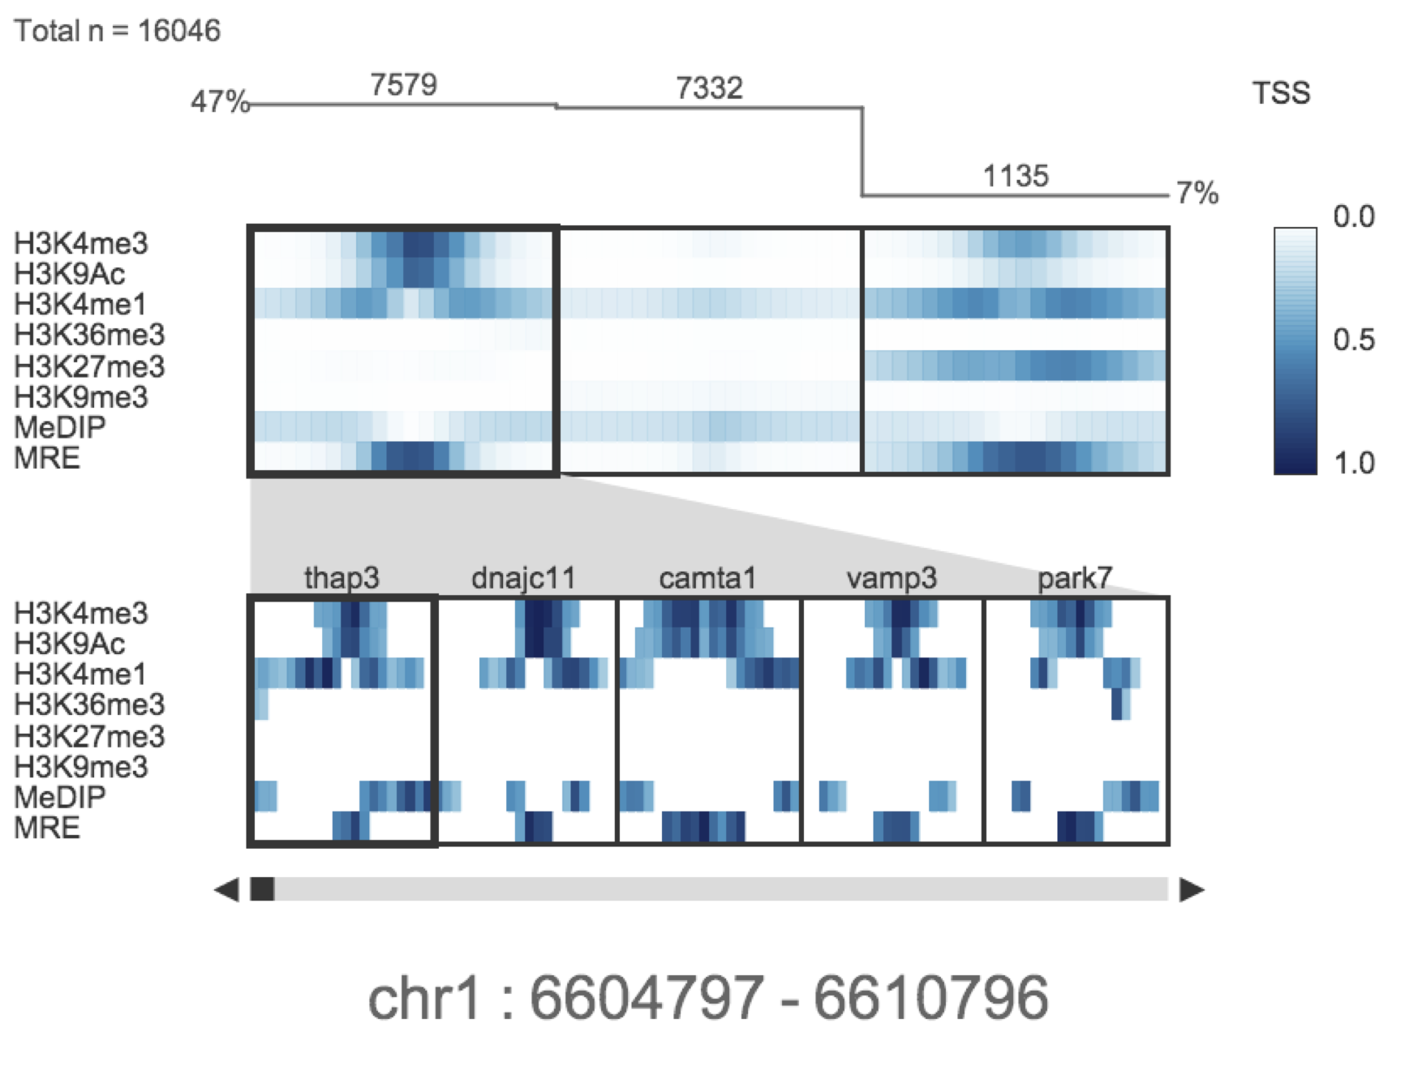
Spark
4. Interactive cluster visualization - data from human H1 embryonic stem cells
CLUSTER DISPLAY
REGION BROWSER
screenshot

Slide 34
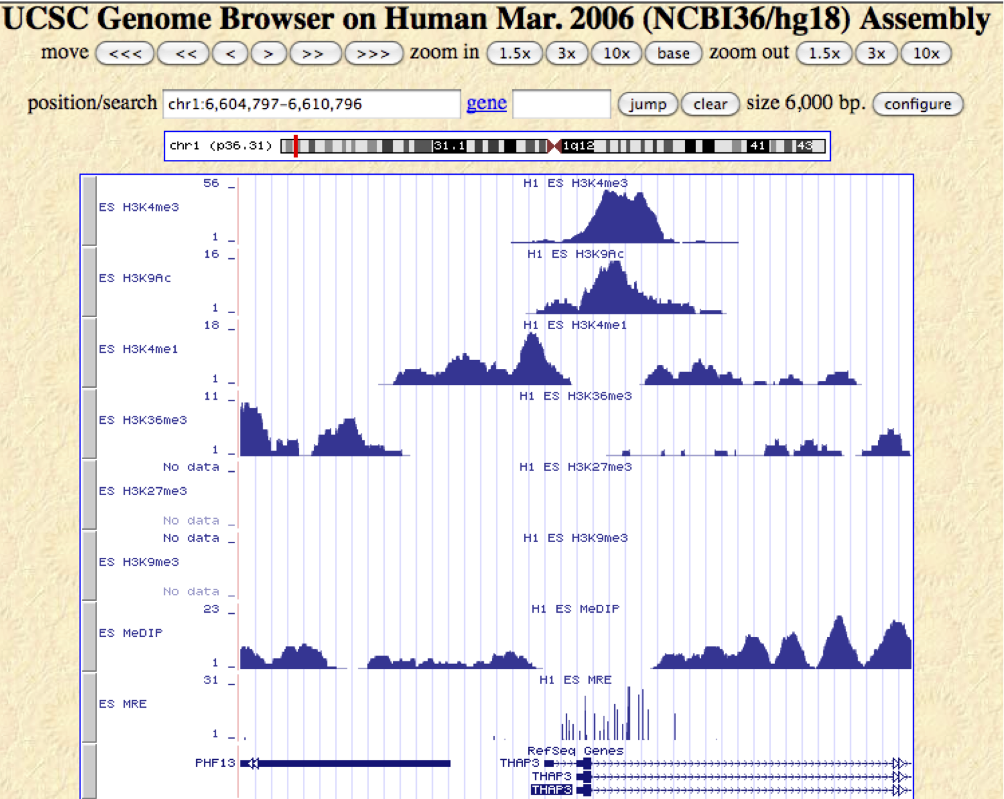
Spark
4. Interactive cluster visualization - data from human H1 embryonic stem cells
hyperlink
screenshot

Slide 35
Spark
4. Interactive cluster visualization - data from human H1 embryonic stem cells
activating + silencing
modifications:
“poised”
screenshot

Slide 36
Spark
Do these clusters have functional meaning?

Slide 37
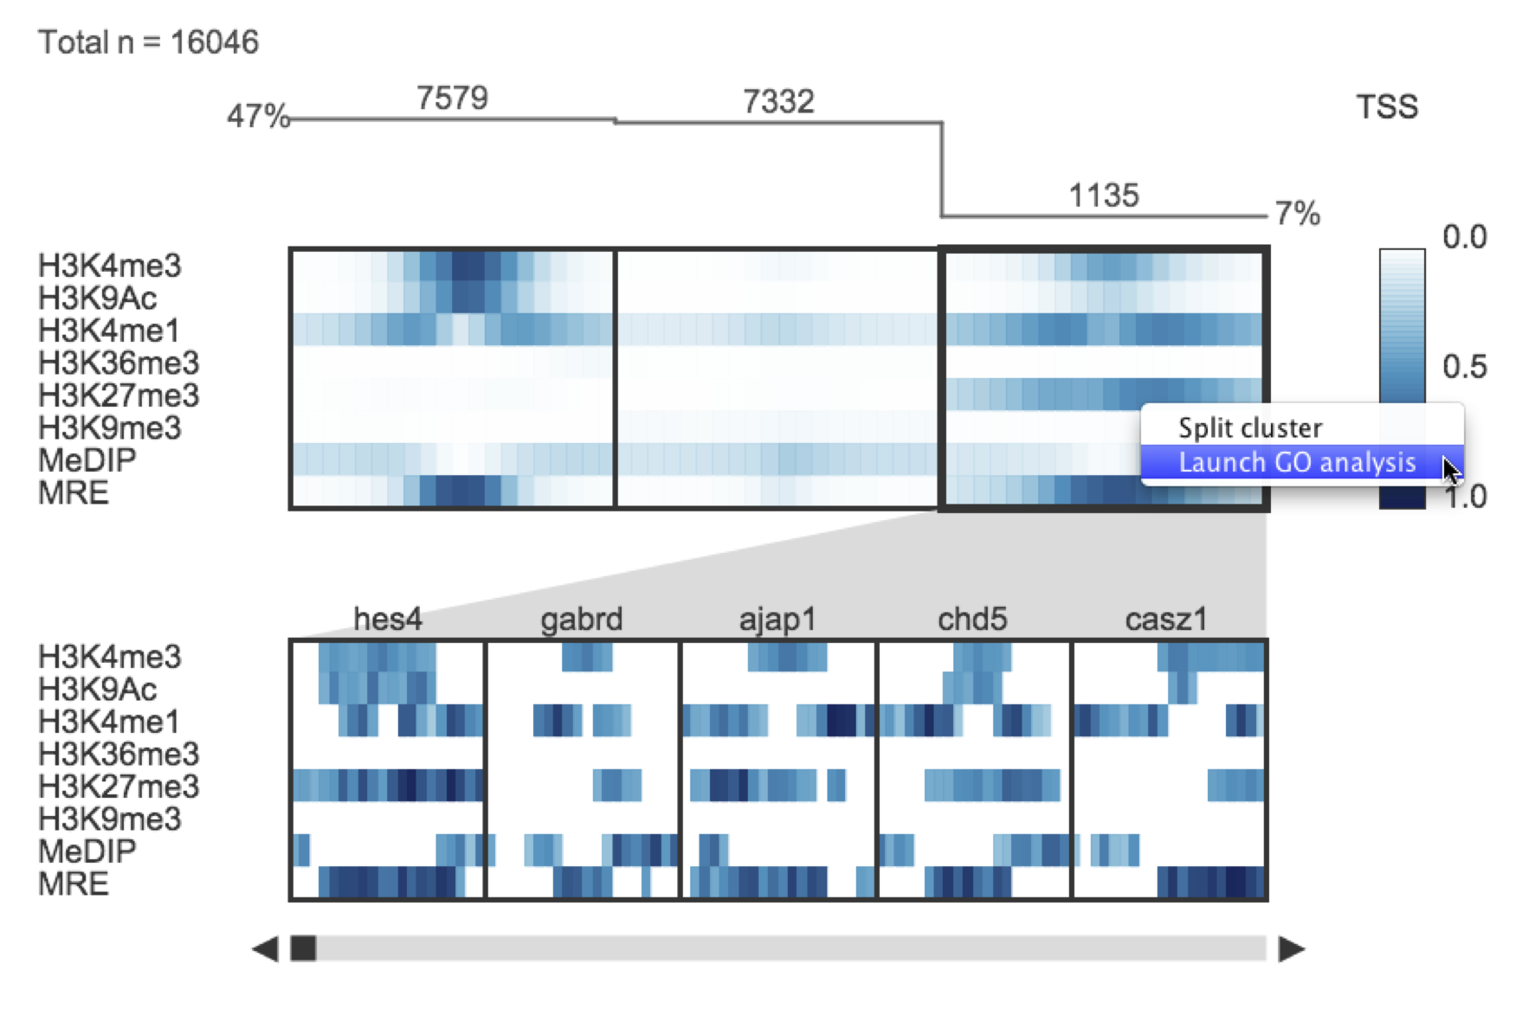
Spark
5. Interactive gene ontology analysis
screenshot

Slide 38
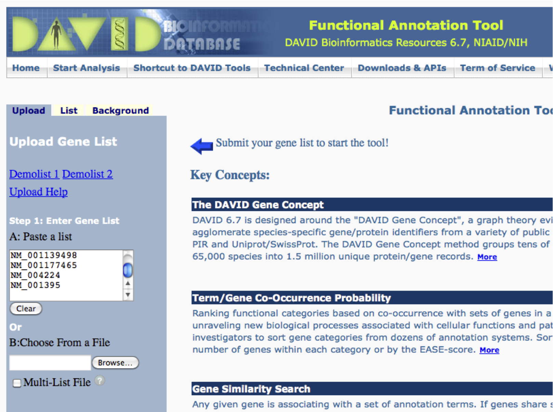
Spark
5. Interactive gene ontology analysis

Slide 39
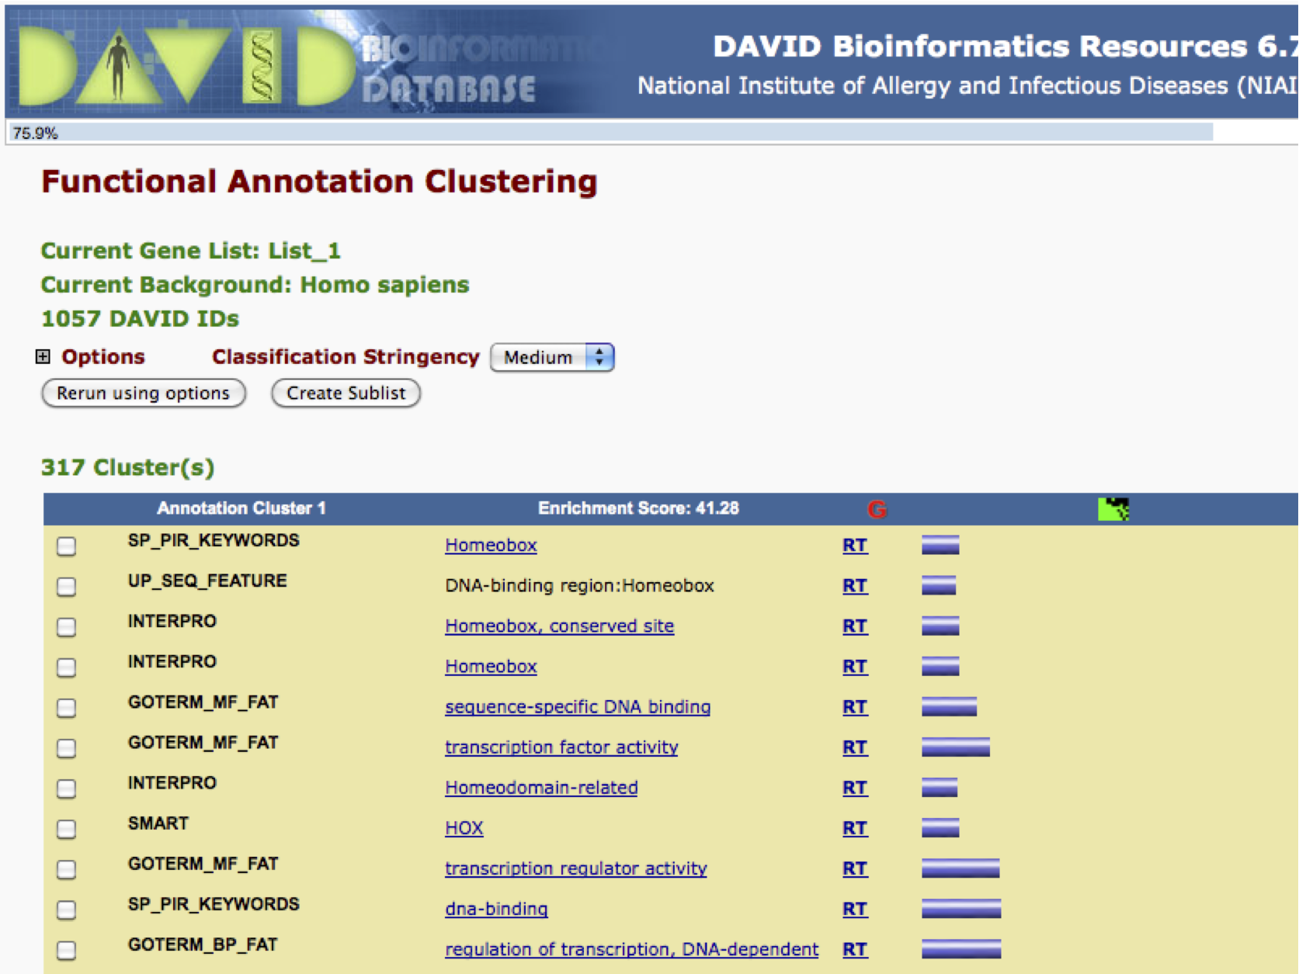
Spark
5. Interactive gene ontology analysis
screenshot

Slide 40
Spark
Do these clusters have distinct gene expression patterns?

Slide 41
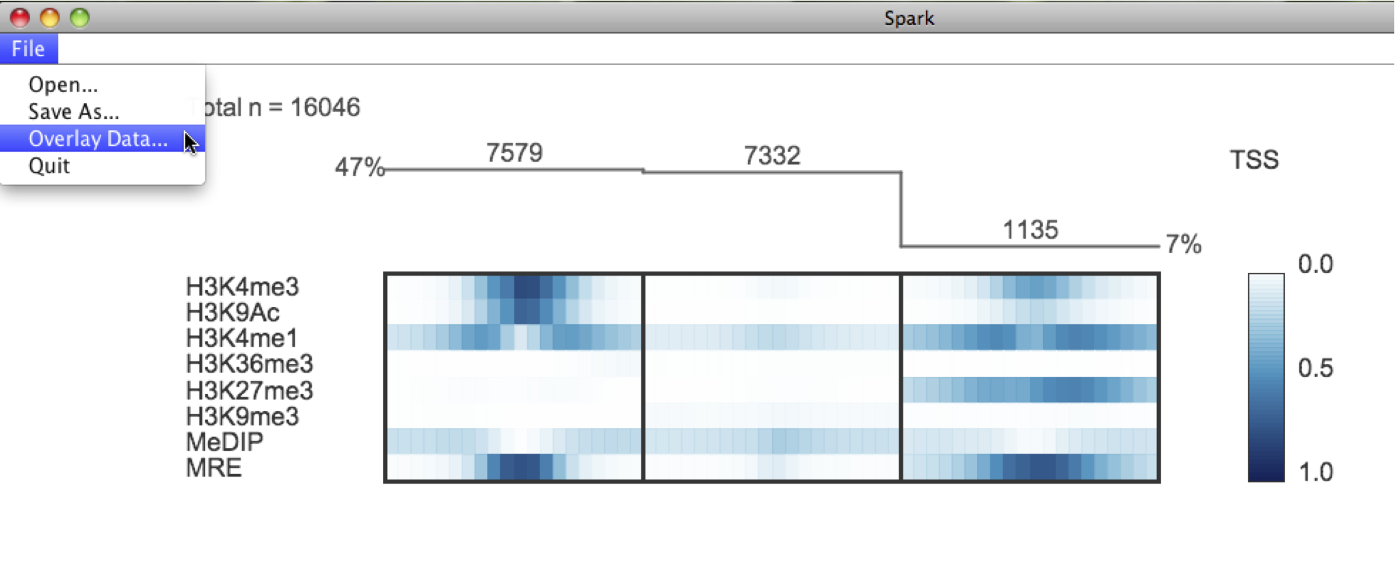
Spark
6. Interactive data overlay
screenshot

Slide 42
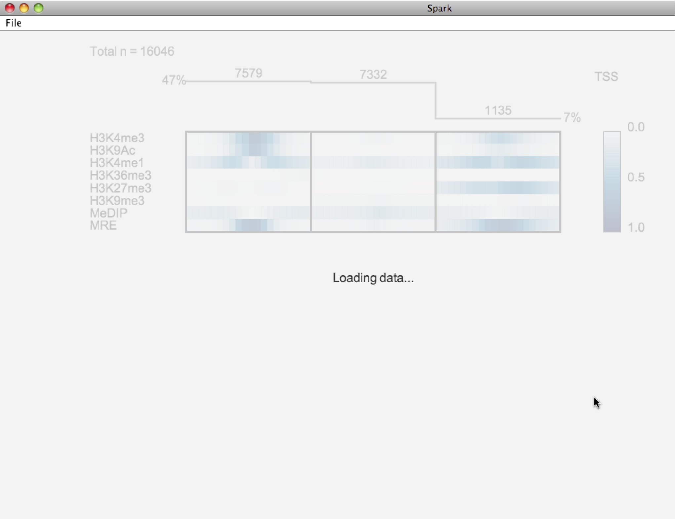
Spark
6. Interactive data overlay
screenshot

Slide 43
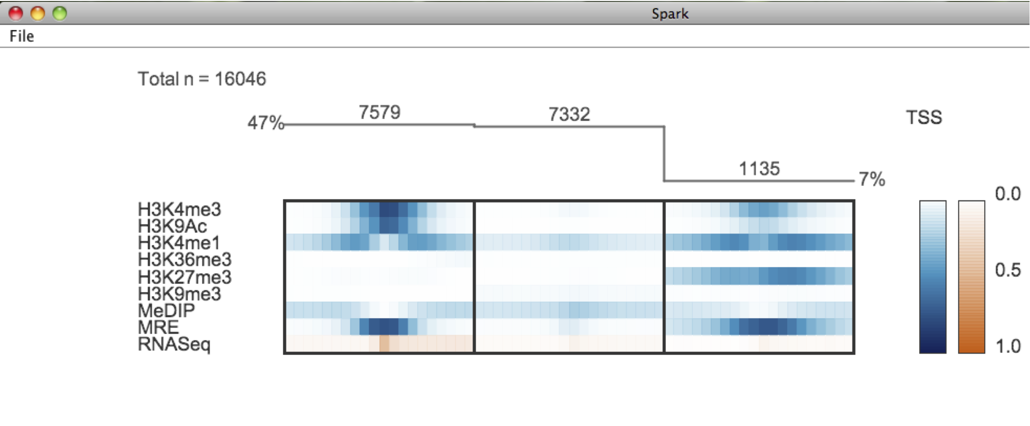
Spark
6. Interactive data overlay
screenshot

Slide 44
Spark
6. Interactive data overlay
Transcriptionally: Active
Inactive
screenshot

Slide 45
Spark
How many clusters should I generate?

Slide 46
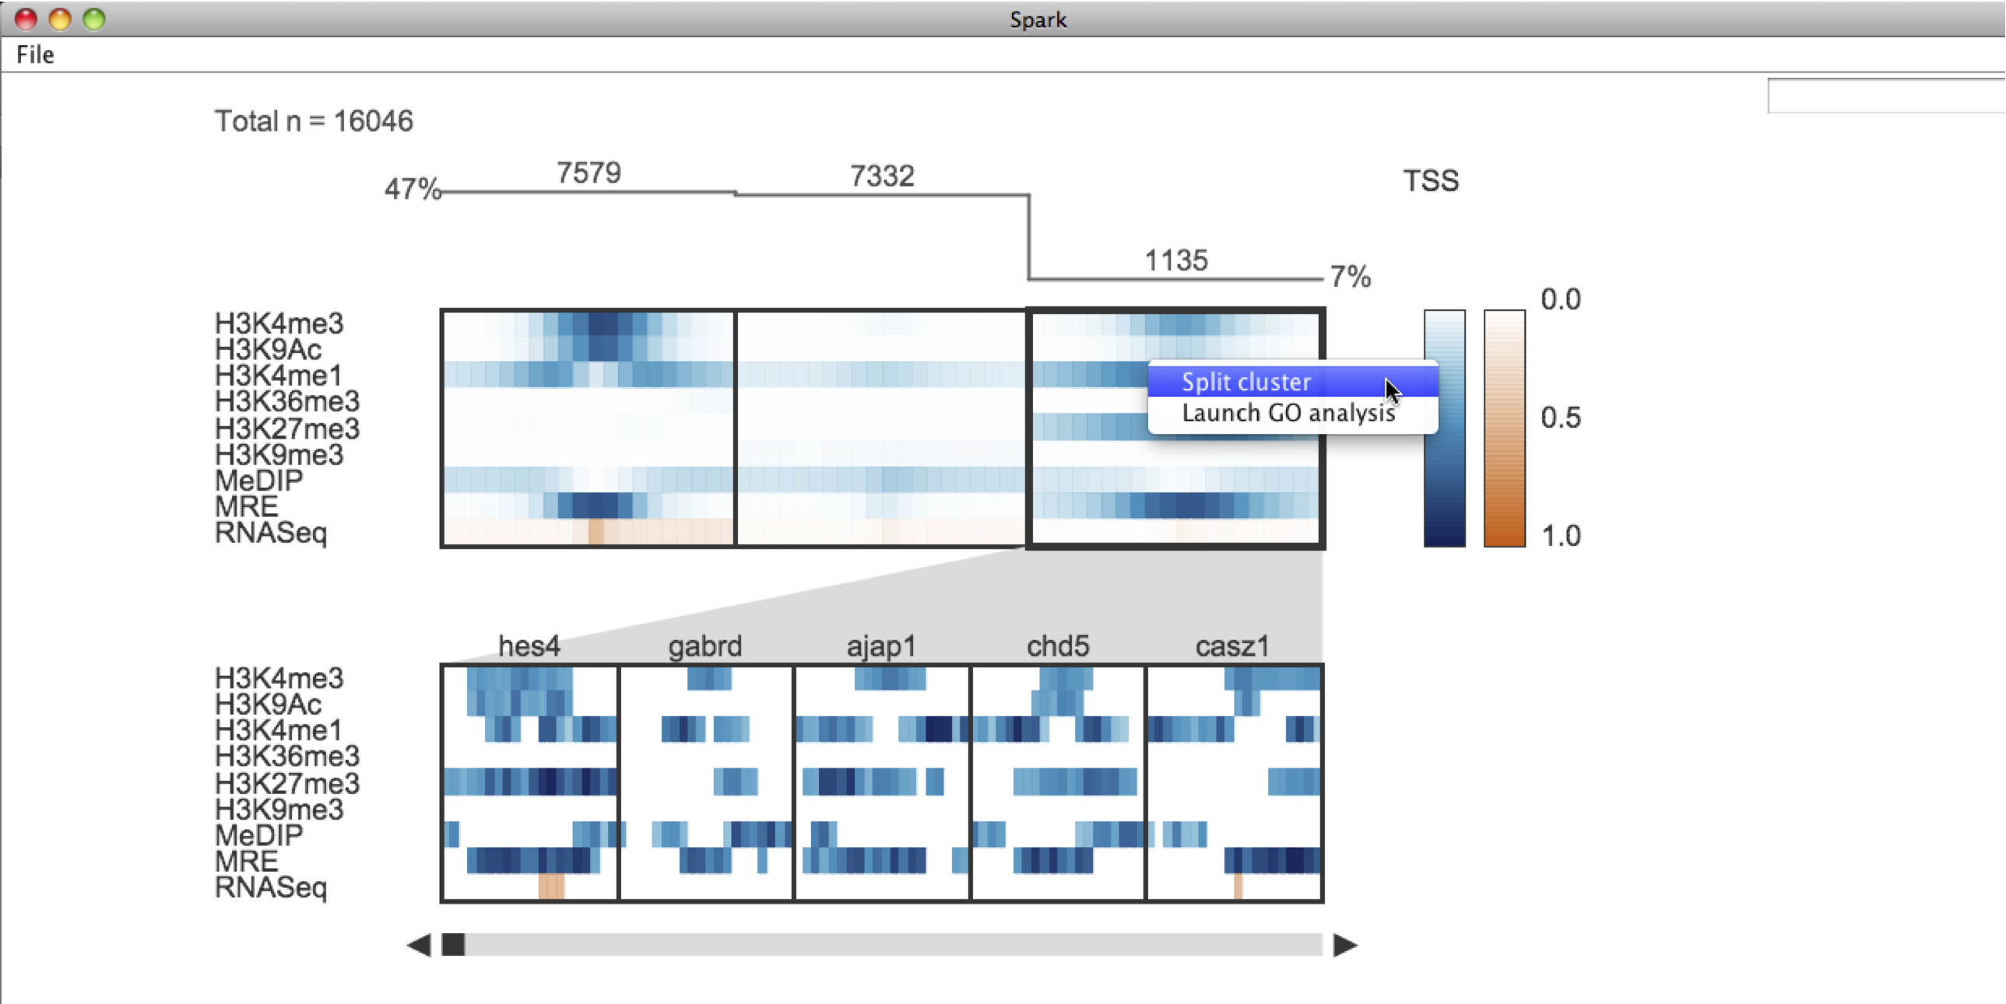
Spark
7. Interactive cluster splitting
screenshot

Slide 47
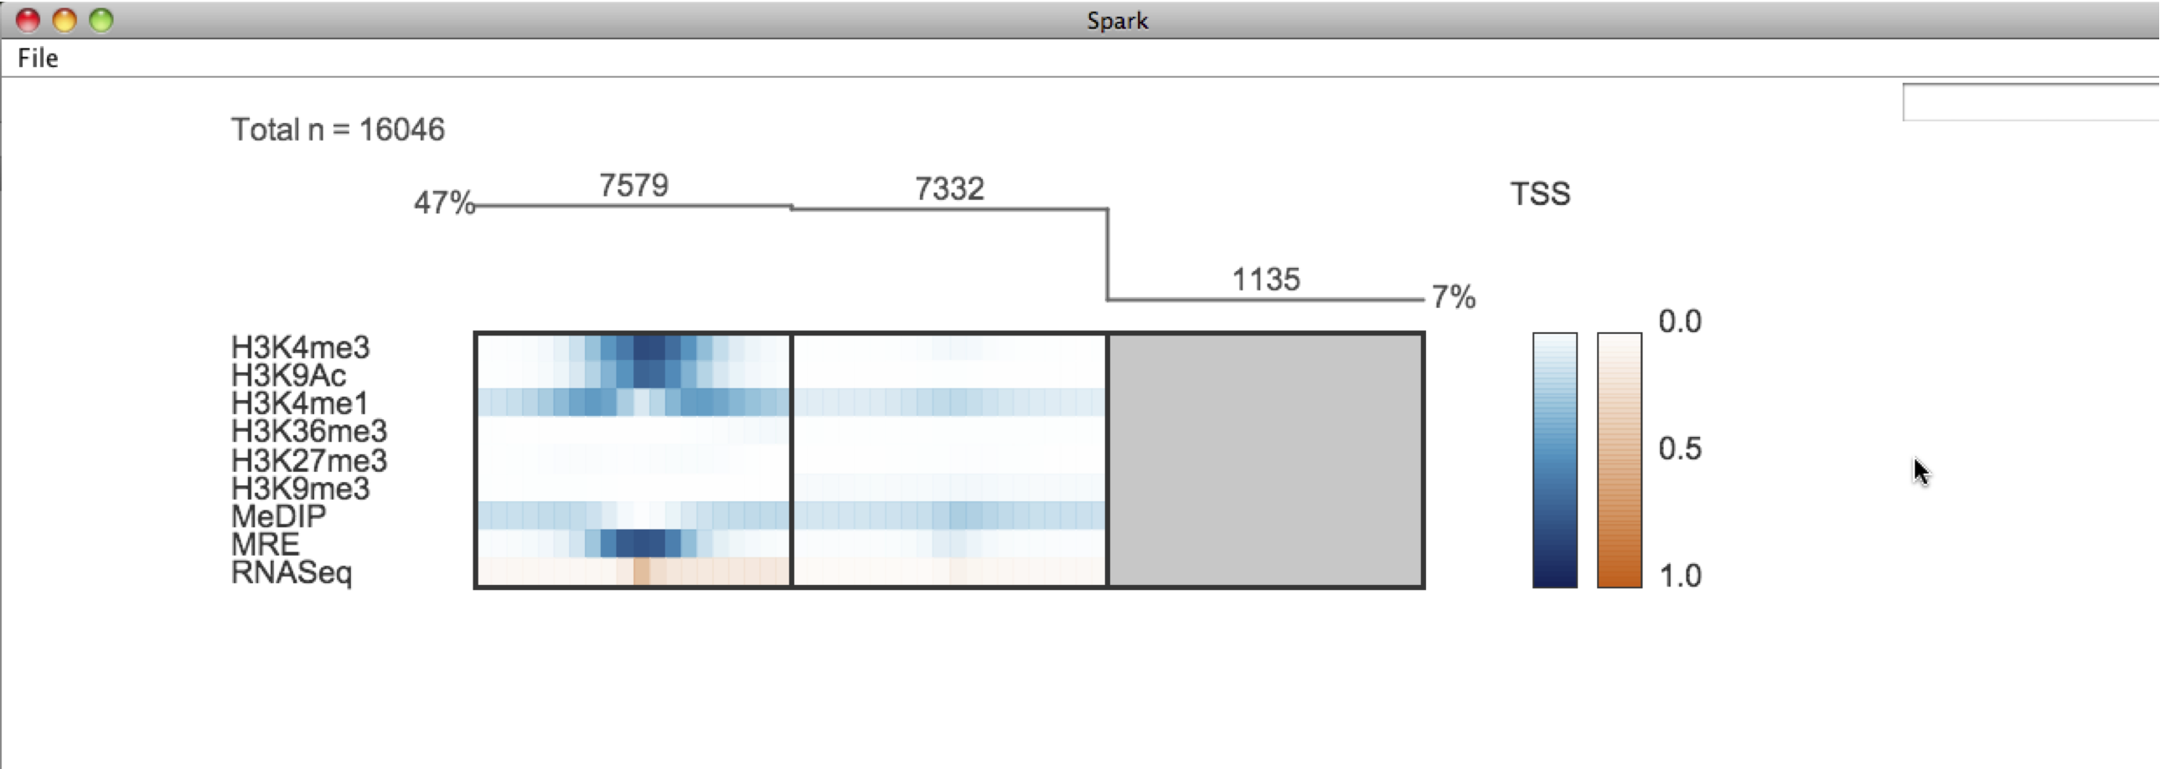
Spark
7. Interactive cluster splitting
screenshot

Slide 48
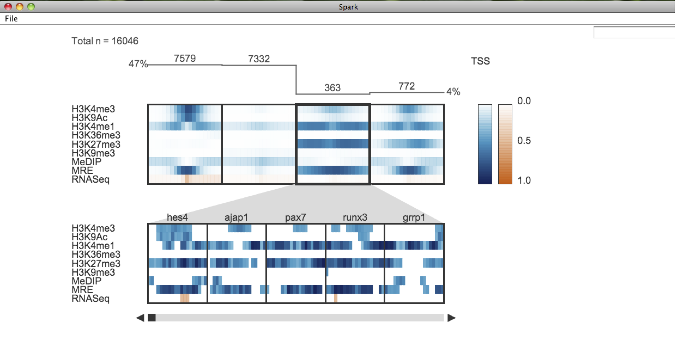
Spark
7. Interactive cluster splitting
screenshot

Slide 49
Spark
7. Interactive cluster splitting
screenshot

Slide 50
Spark
Where is my favorite gene?
What other genes have similar data patterns?

Slide 51
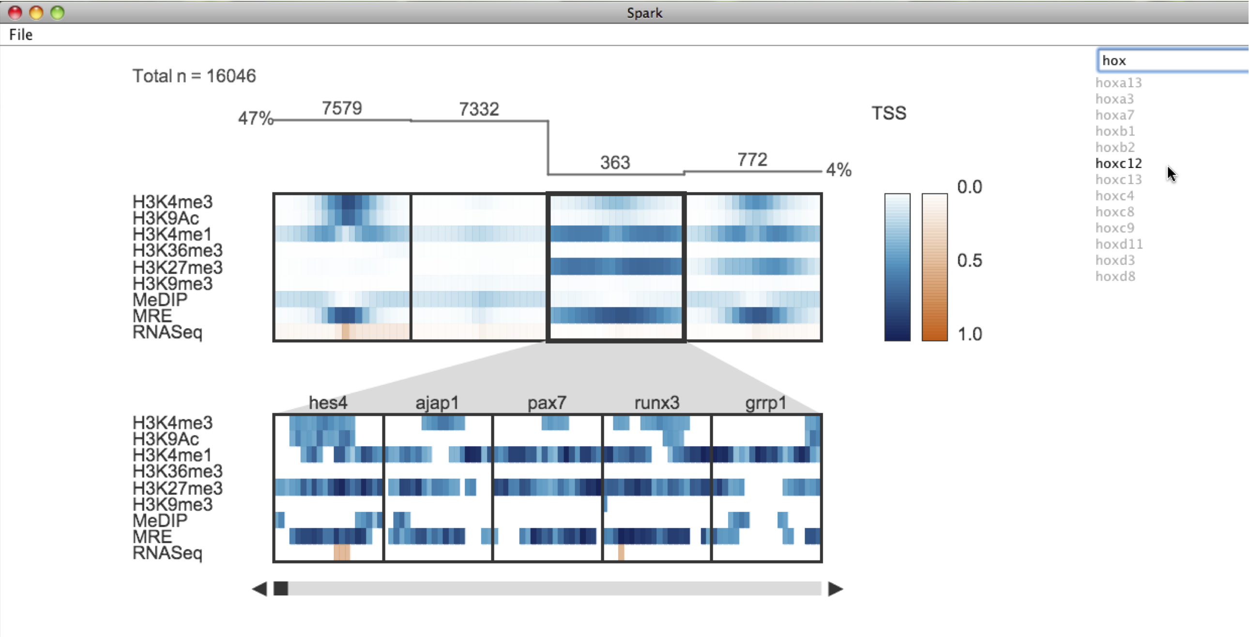
Spark
8. Finding genes of interest
screenshot

Slide 52
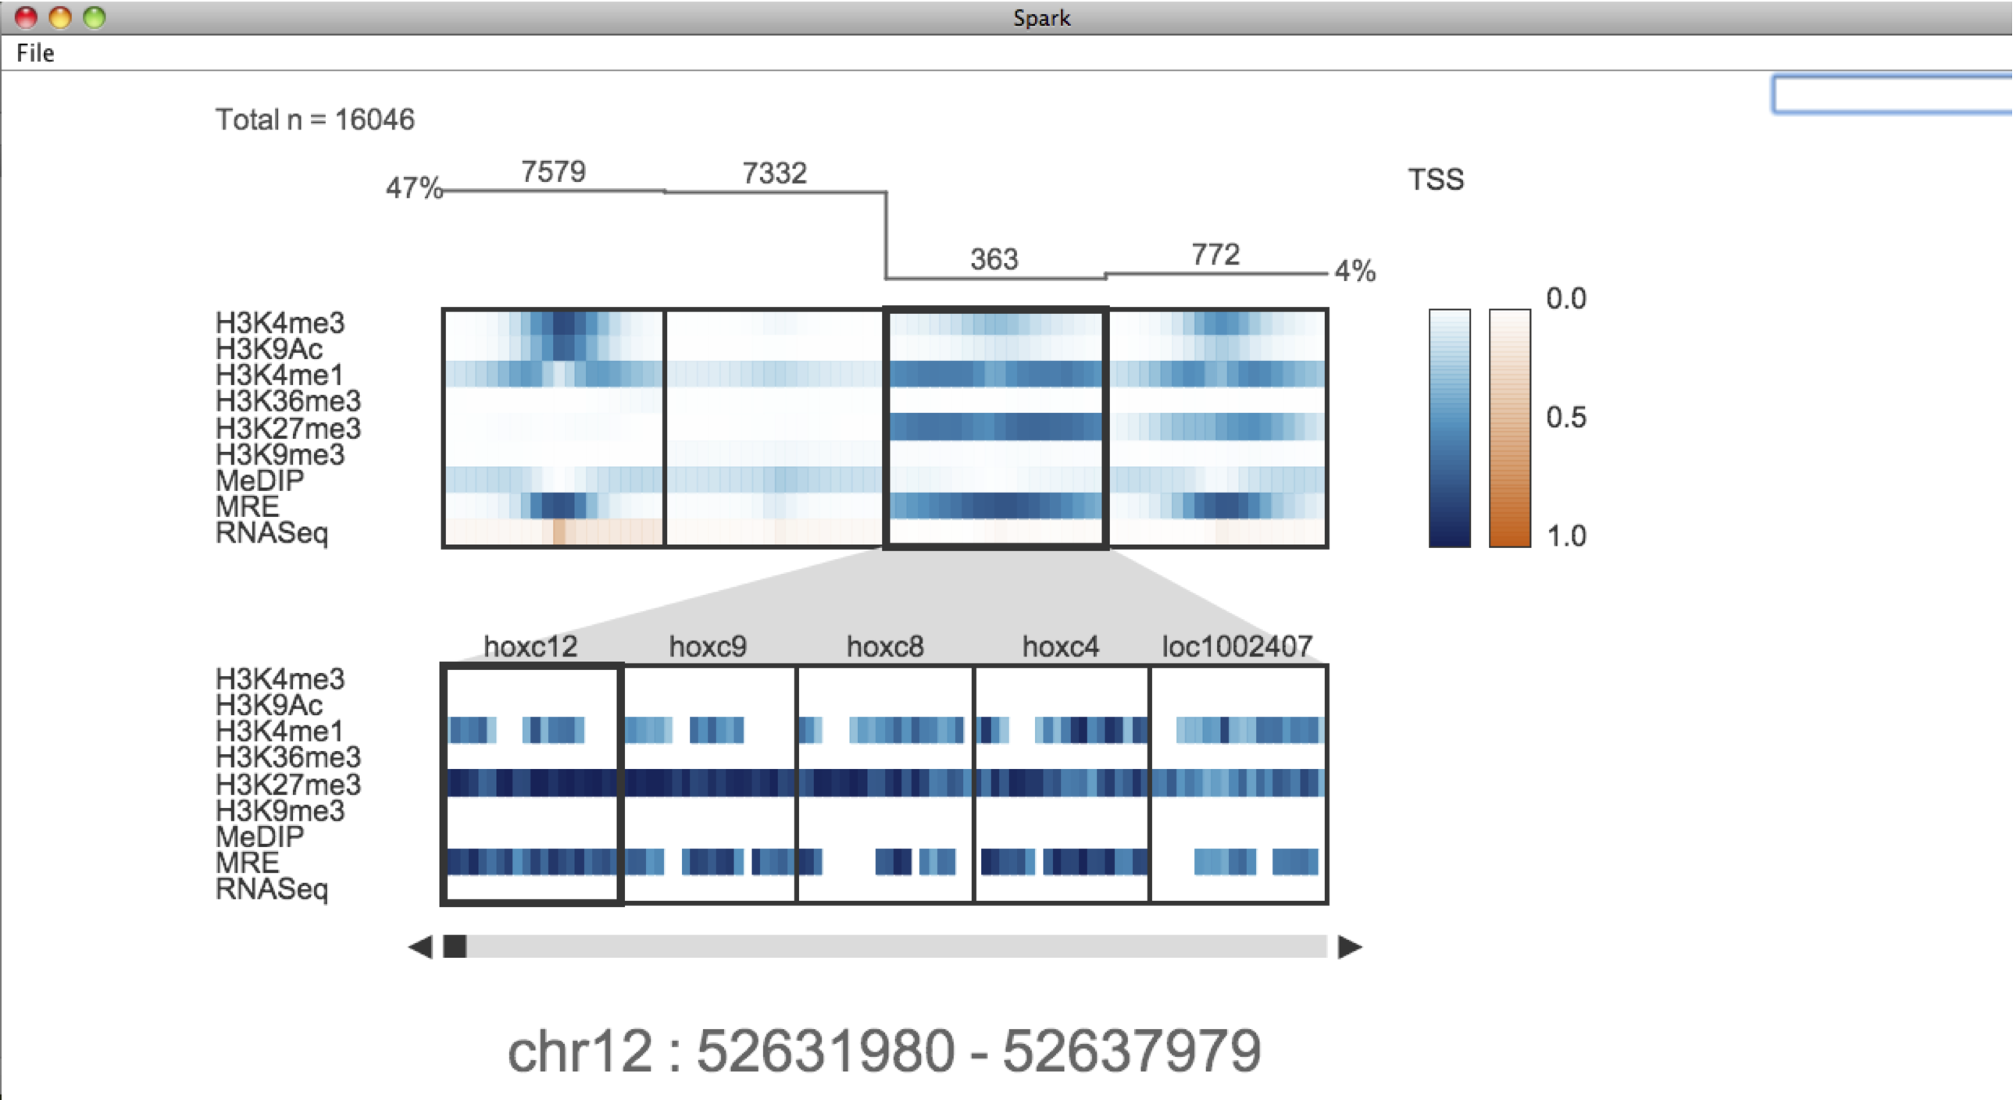
Spark
8. Finding genes of interest
screenshot

Slide 53
Spark - technical details

Slide 54
Spark - technical details
NUMBER OF CLUSTERS
(e.g. 5)
DATA FILE
(wig or bigWig)
REGION SET
(GFF3)
DATA TABLE
CLUSTERS
VISUALIZATION
BIN NUMBER
(e.g. b=10)
.dat
.stats
.values
.GFF
OUTPUT FILES

Slide 55
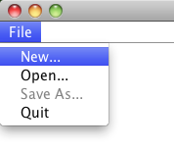
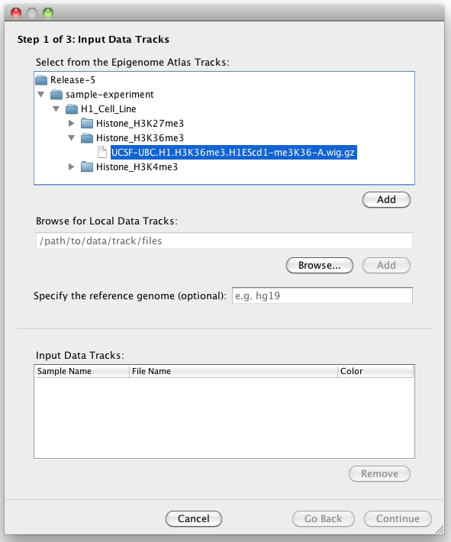
Spark - technical details
Step 1
Select from the Epigenome Atlas data tracks
Or browse for local wig files or paste a URL
This Epigenome Atlas Tracks tree above is populated from an XML file containing the directory structure from www.genboree.org/epigenomeatlas and therefore can very easily be updated to reflect new data releases

Slide 56
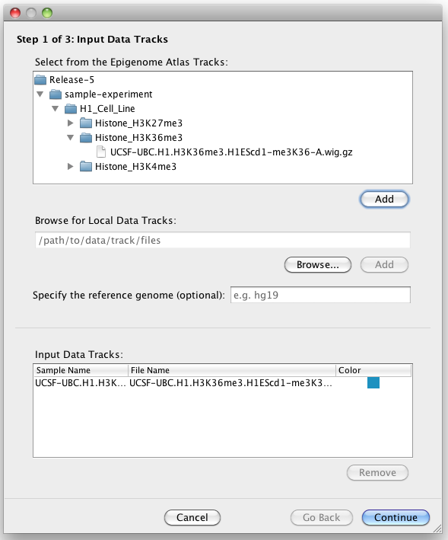
Spark - technical details
Step 1
Your selections can then be added to the input data table below, in which you can edit the sample name and display colour.

Slide 57
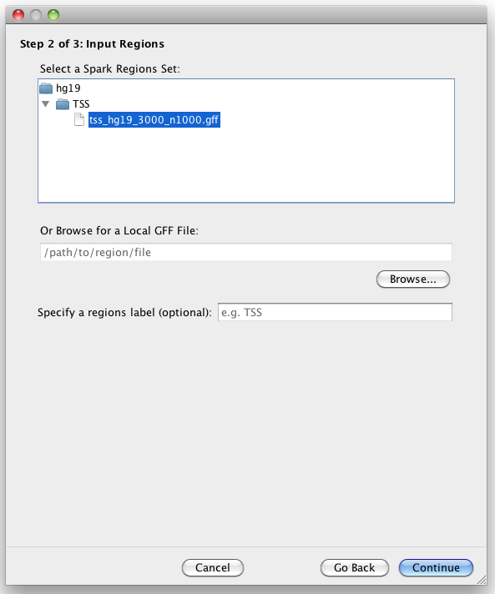
Spark - technical details
Step 2
Select from a provided set of region files
Or browse for local GFF file

Slide 58
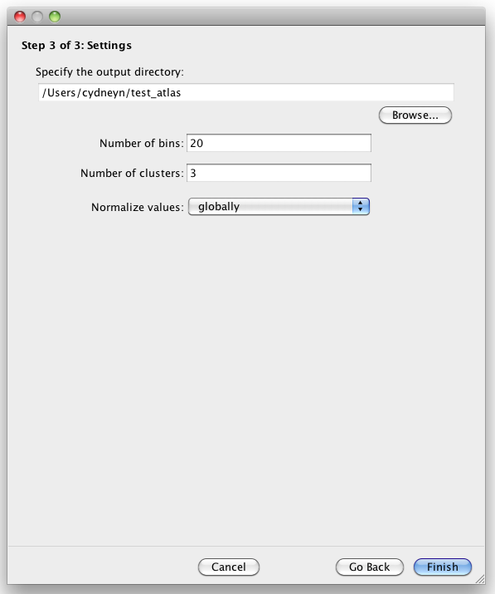
Spark - technical details
Step 3
Specify where to save your analysis
Adjust clustering parameters or use provided defaults
In cases where the user selects an Epigenome Atlas data track and one of the provided region sets, Spark makes use of pre-computed data files that greatly increase performance.
If you want to use a custom region set with an Epigenome Atlas data track, Spark handles all of the data file downloading and caching to keep things simple.
You’re done!
Spark will generate and display your clustering

Slide 59
Demo

Slide 60
Future work
Heatmaps are not the best representation

Slide 61
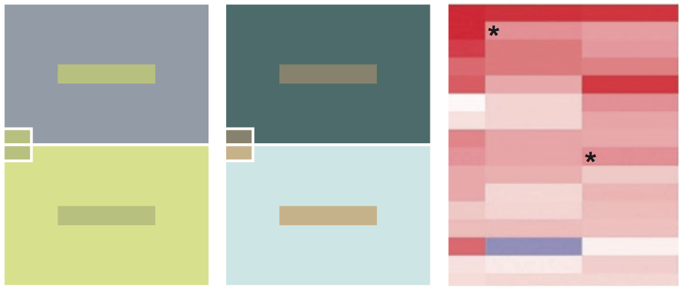
Future work
Heatmaps are not the best representation
Same colour looks different
Different colour looks the same
* These rectangles have the same colour but look different
Bang Wong, Nature Methods, 2010

Slide 62

Future work
Heatmaps are not the best representation
  Histograms would be better (also capture variation)

Slide 63
Future work
Heatmaps are not the best representation
  Histograms would be better (also capture variation)
Greater functionality for manipulating clusters
  Merge clusters
  Edit current settings

Slide 64
Future work
Heatmaps are not the best representation
  Histograms would be better (also capture variation)
Greater functionality for manipulating clusters
  Merge clusters
  Edit current settings
Input files likely require filtering
  could filter data based on an input peak set

Slide 65
Future work
Heatmaps are not the best representation
  Histograms would be better (also capture variation)
Greater functionality for manipulating clusters
  Merge clusters
  Edit current settings
Input files likely require filtering
  could filter data based on an input peak set
More directly support data driven region selection

Slide 66
Future work
Heatmaps are not the best representation
  Histograms would be better (also capture variation)
Greater functionality for manipulating clusters
  Merge clusters
  Edit current settings
Input files likely require filtering
  could filter data based on an input peak set
More directly support data driven region selection
Spark may not perform well in detected a small subpopulation with a particular pattern

Slide 67
Spark releases
Public release (old)
http://www.bcgsc.ca/platform/bioinfo/software/spark
Current version (significantly updated; in testing)
http://www.bcgsc.ca/downloads/spark/v1.1.0/start.jnlp

Slide 68




Acknowledgements
BCGSC
Steve Jones (advisor)
Marco Marra
Martin Hirst
Misha Bilenky
Gordon Robertson
Yongjun Zhao
Martin Krzywinski
Sequencing Team
Bioinformatics Group
LIMS
UCSF
Joe Costello
Chibo Hong
Ravi Nagarajan
Thea Tlsty
Philippe Gascard
Mahvash Sigaroudinia
Art Weiss
Terri Kaldecek
Michael McManus
Hunter Richards
Yun Choi
Susan Fisher
Olga Genbacev
UC Davis
Peggy Farnham
Henny O’Geen
Lorigail Echipare
Vitalina Komashko
Kimberly Blahnik
UCSC
David Haussler
Tracy Ballinger
Washington Univ.
Ting Wang

