Slide 1


Elucidating the relationship between H3K36 and H3K27 trimethylation across normal and malignant tissue types
Cameron Herberts
GSAT rotation project update: December 5th 2018
Hirst Lab

Slide 2
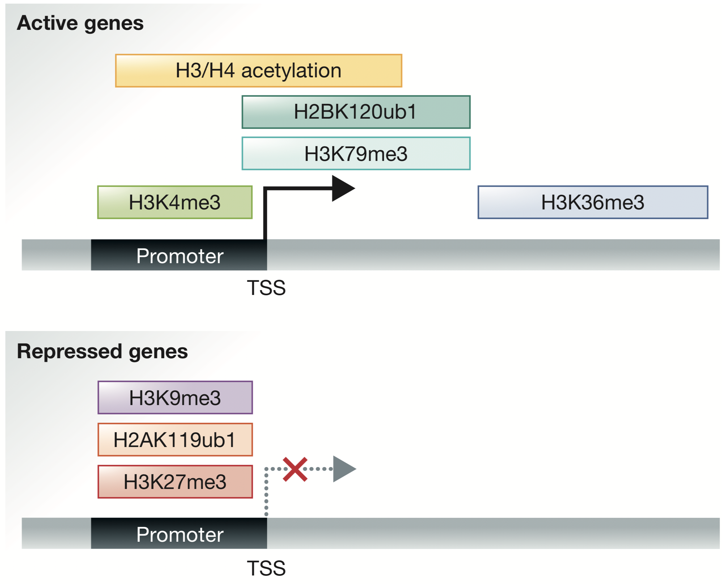
Histone H3K27 and H3K36 trimethylation in non-malignant cells
H3K27me3 and H3K36me3 are typically associated with transcriptional repression and activation, respectively, and usually exhibit mutual exclusivity.
Increasing evidence of crosstalk between H3K36me2/3 and H3K27me3 modifiers:
  H3K36me3 shown to inhibit PRC2 subunit EZH2, preventing the spreading of H3K27me3.
  Conversely, PRC2 subunit PHF19 may recruit H3K36me3 demethylase NO66 to H3K36me3 sites.
Fig 1. Conventional distribution of H3K36 and H3K27 trimethylation marks.
Zhang et al., EMBO rep. 2015
Notes:
H3K27me3 and H3K36me3 are common histone markers that are classically associated with transcriptional silencing and activation, respectively.
Growing evidence of a complex regulatory relationship between these two histone markers in non-malignant cells.
It has been shown that H3K36me2/3 directly inhibits the EZH2 subdomain of Polycomb complex PRC2, preventing the spreading of K27me3—this has been postulated as the reason why K36me3 marks tend to be broad and genome-wide.
Conversely, it has been shown that PRC2 subunit PHF19 associates with H3K36me3 demethylase NO66, and recruits both PRC2 and NO66 to K36me3 markers. This causes an opposite effect, where H3K36me3 markers create a template for Polycomb repression. This interaction was observed when investigating how active genes are transcriptionally silenced during cell lineage commitment.
It is clear that there is interplay between the regulatory machinery responsible for both histone markers, and that this may be important in development processes (lineage commitment). However the full picture of this is not yet clear. Additionally, there have been recent observations of this occurring in cancer.

Slide 3
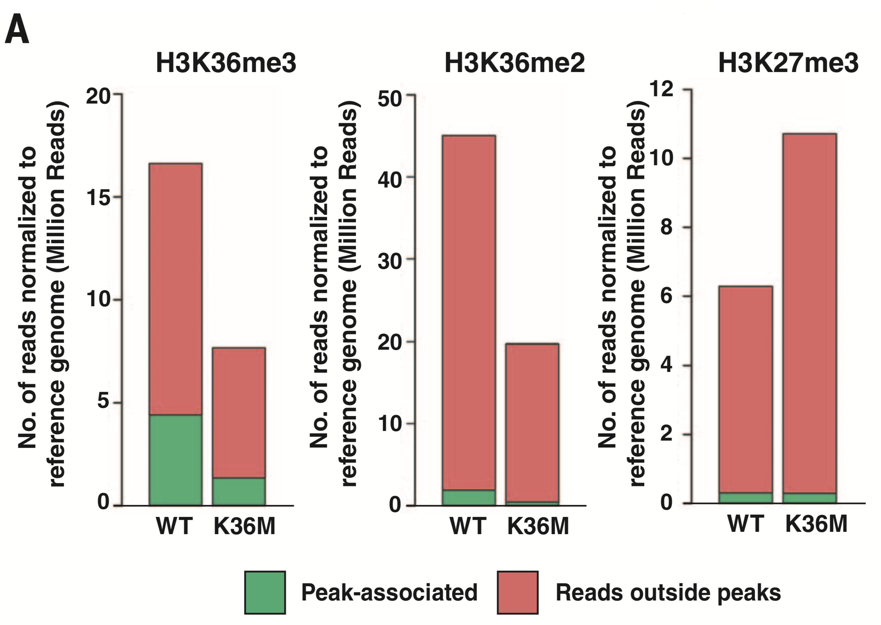
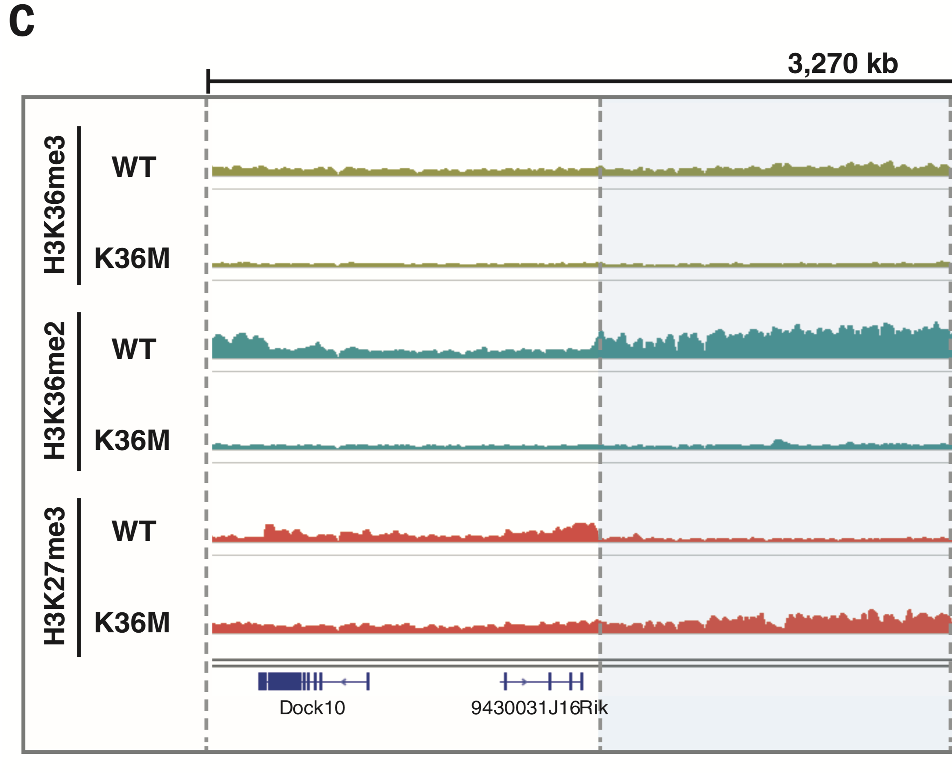
Redistribution of H3K27me3 and HeK36me3 in cancer
Cancer-associated H3 (K36M) mutations co-localize with sites of H3K27 and H3K36 methylation and alter typical binding patterns.
Disruptions to H3K36 methylation cause depletion of H3K36me3 and expansion of H3K27me3.
  Impairs differentiation of mesenchymal progenitor cells and is sufficient for sarcoma tumorigenesis.
Interplay of H3K27me3 and H3K36me3 seems to have an oncogenic role in pediatric cancers.
Fig 2. Genome-wide depletion of H3K36me3 allows for expansion of H3K27me3.
Lu et al., Science 2016
Notes:
H3K27me3 and H3K36me3 are common histone markers that are classically associated with transcriptional silencing and activation, respectively.
Growing evidence of a complex regulatory relationship between these two histone markers in non-malignant cells.
It has been shown that H3K36me2/3 directly inhibits the EZH2 subdomain of Polycomb complex PRC2, preventing the spreading of K27me3—this has been postulated as the reason why K36me3 marks tend to be broad and genome-wide. A similar effect is observed for H3K4me3 (ability to inhibit PRC2 complex). Hence its unclear how activating signals are removed and replaced with repressive signals in the context of development.
Conversely, it has been shown that PRC2 subunit PHF19 associates with H3K36me3 demethylase NO66, and recruits both PRC2 and NO66 to K36me3 markers. This causes an opposite effect, where H3K36me3 markers create a template for Polycomb repression. This interaction was observed when investigating how active genes are transcriptionally silenced during cell lineage commitment.
It is clear that there is interplay between the regulatory machinery responsible for both histone markers, and that this may be important in development processes (lineage commitment). However the full picture of this is not yet clear.
This relationship appears to be disrupted in the context of certain cancers, namely pediatric cancers like glioma and glioblastoma (pediatric cases). In a 2016 Science paper published by David Allis, Nada Jabado, and Peter Lewis showed that mutations to the H3K36 marker (lysine to methionine) inhibits activity of several H3K36 methyltransferases, allowing for an expansion of K27 methylation in their place as a consequence. This was validated at multiple levels (either through incurring mutations at lysine 36, or knocking down H3K36 methyltransferases individually and in tandem). Nsd1, Nsd2, and Setd2 (all H3K36 methyltransferases)

Slide 4
Elucidating the relationship between H3K36 and H3K27 trimethylation across normal and malignant tissue types
Aim: to characterize the relationship between H3K36 and H3K27 trimethylation in cancer and clarify its possible oncogenic role.
Exploratory analysis across multiple datasets comprising 110 paired samples:
  91 from Centre for Epigenome Mapping Technologies (CEMT) consortium (normal + tumor samples).
  15 from NCI Rhabdoid tumor project (tumor, cell lines, embryonic stem cells).
  4 small cell carcinoma of the ovary hypercalcemic type (SCCOHT) tissues.
Whole-genome H3K36me3 and H3K27me3 ChIP-Seq data available for all samples.
Notes:
110 different samples (91 from CEMT consortium (normal and tumor samples), 15 from NCI Rhabdoid Tumor project (tumors, cell lines and embryonic stem cells), 4 SCCOHT tissues)

Slide 5
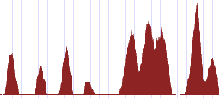
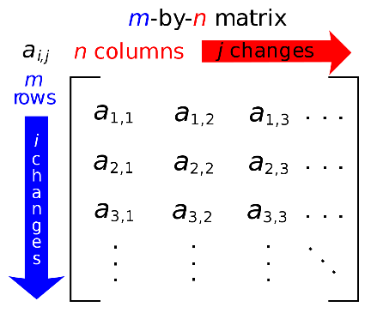
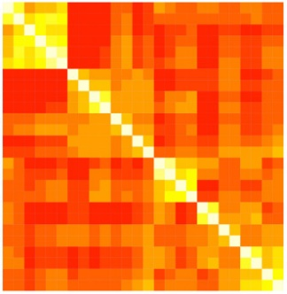
Analysis methodology
Example_file.bam
Bam file
Bam2Wig
Bam files representing raw hg19 aligned reads from H3K27me3 and H3K36me3 ChIP-Sequencing is converted to fixed-step Wig files.
Normalized coverage in select regions (TSS +/- 2kb) is calculated and returned as a bed file.
Coverage data for each sample is merged on genomic coordinate to produce a data matrix.
Amalgamation of meta-data and clarifying missing fields (ongoing)
Wig file
RegionsCoverageFromWigCalculator.jar
Coverage bed file
Data matrix
Fig 3. Schematic of analysis pipeline.
Notes:
- The regionscoveragefromwigcalculator operates on subsets of the genome.

Slide 6
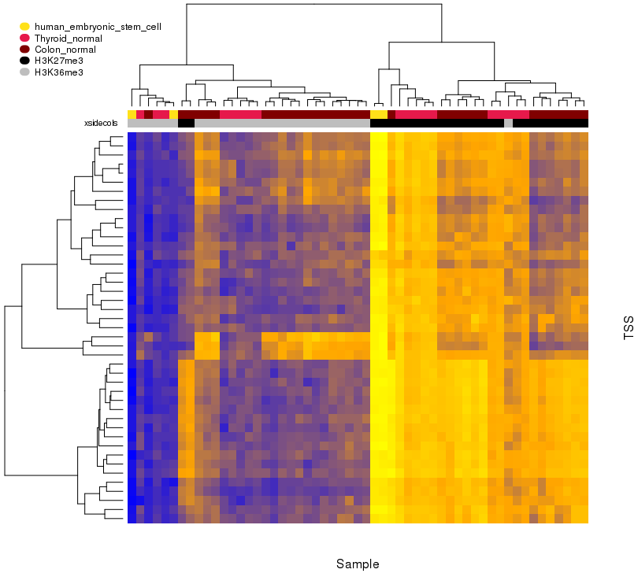
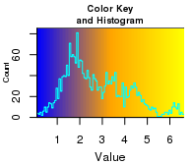
Evidence of H3K36me3 and H3K27me3 mutual exclusivity in normal cells
Initial focus on the TSS regions of HOX gene clusters in non-malignant cell types.
  HOX genes are often repressed in terminally differentiated cells.
Normal cells are enriched for H3K27me3 and lack H3K36me3, and generally segregate according to histone marker.
Confirmation / quality-check of anticipated behaviour in normal cells.
Fig 4. H3K36me3 and H3K27me3 coverage heatmap in normal cells.
Notes:
Mention outliers

Slide 7
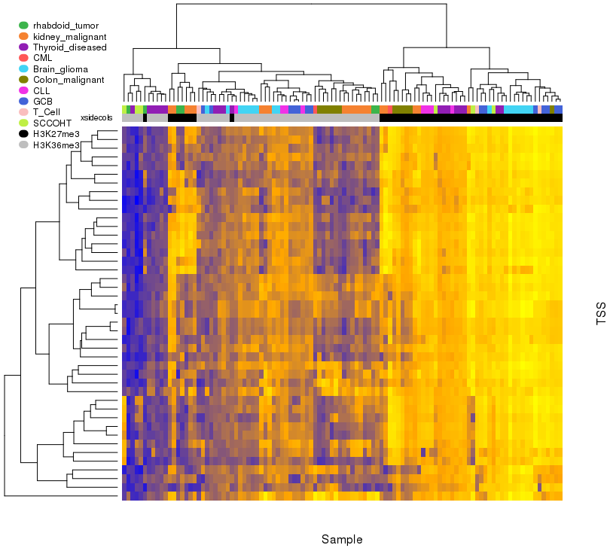
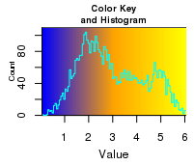
Distribution of H3K36me3 and H3K27me3 in tumour cell-types is less distinct
Fig 5. H3K36me3 and H3K27me3 coverage heatmap in tumour cells.
Gross enrichment of H3K36me3 coverage in HOX genes compared to normal cells (despite similar clustering behaviour).
Initial evidence of a shift in distribution between active and repressive histone marks.

Slide 8
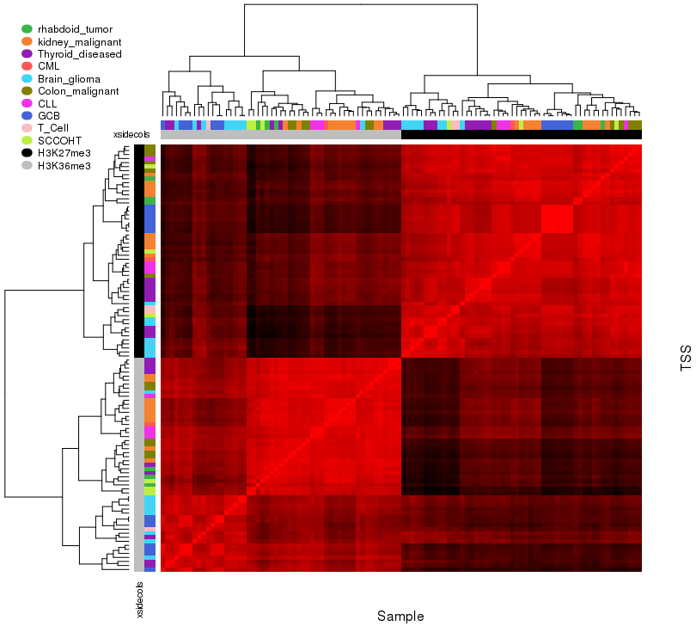
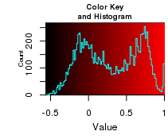
Distribution of H3K36me3 and H3K27me3 in tumour cell-types is less distinct
Pairwise correlation among tumour samples shows clear clustering based on histone marker.
Correlation across samples representing different histone markers is less distinct in brain glioma and germinal centre B-cell (GCB) cancers.
  H3K27M mutations and subsequent H3K36me3 depletion / H3K27me3 expansion has been observed in pediatric brain gliomas.
Fig 6. Pairwise genome-wide sample coverage correlation heatmap (tumour only).

Slide 9
Concluding remarks + future work
H3K36me3 and H3K27me3 redistribution may have oncogenic implications in certain cancers.
This is a preliminary analysis aimed at characterizing H3K36me3 / H3K27me3 histone marker distributions—leveraging a large, heterogenous collection of samples.
Next steps: identify regions of differential H3K36me3 and H3K27me3 binding across tumor/normal samples.
  Multiple options further exploration: Peak calling, gene-set enrichment analyses (GSEA), motif enrichment analysis, etc.

Slide 10
Acknowledgements
Dr. Martin Hirst
Alice Zhu
Alireza Lorzadeh
Alvin Qiu
Annaick Carles
Edmund Su
Evan Gibbard
Jasper Wong
Jonathan Steif
Linda Wang
Luolan (Gloria) Li
Marcus Wong
Michelle Moksa
Misha Bilenky
Qi (Rachelle) Cao
Raisa Shabbir
Rashedul Islam

